Slide 1
INSTRUCTIONS FOR USE
Bioventus PPT Template

Slide 2
Am I using the right template?
You are using the wrong template if:
  Purple bar at top of content slides
  Athletes with dust particles
  Dust on any page
  Master pages naming convention does not begin with “BV”
    Wrong page names: Title Slide, 2_Title Slide, 1_Title Slide, 3_Title Slide, Title and Content, Blank, SNˆL002, SNˆL050, or any variation of SNˆ.
You are using the correct template if:
  Slides are primarily white
  Slides consist of colored square with horizontal lines
  Bioventus logo is located bottom right

Slide 3
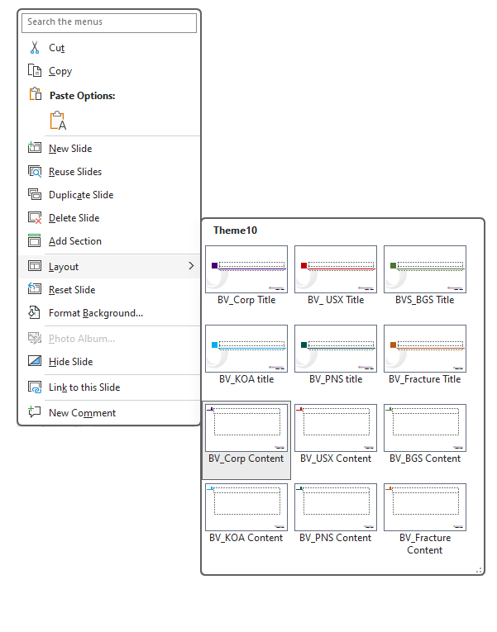
Check your template
Right click on any slide in your presentation and
select “Layout”
  You should have 12 layout options.
    6 BV_Title Slides (1 for Corp, and 1 for each division of the company)
      BV_Corp Title
      BV_USX Title
      BV_BGS Title
      BV_KOA Title
      BV_PNS Title
      BV_Fracture Title
    6 BV_Content Slides (1 for Corp, and 1 for each division of the company)
      BV_Corp Content
      BV_USX Content
      BV_BGS Content
      BV_KOA Content
      BV_PNS Content
      BV_Fracture Content
  If these options are not available you are using the wrong template

Slide 4
Correctly Importing Slides into template
Select all slides from old presentation
Drag and drop them into the new presentation (or copy and paste)
In paste options dialogue box select: Use Destination Theme
Check presentation for accurate conversion
If a slide was not converted
    Select slide
    Right click on slide
    Select Layout and choose correct slide template (all pages in the correct template begin with BV)
  Note: to reduce file slides go into Master Slides and delete templates that were brought in

Slide 5
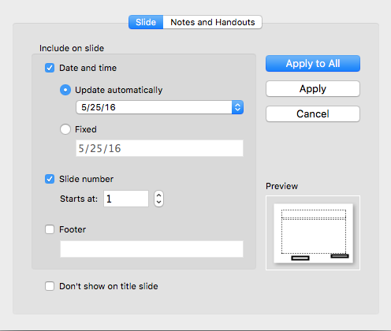
Missing Confidential Date, and Page Number
Select the Insert Tab
Select Date & Time
Check Date and Time and Slide number
Press Apply to All

Slide 6




Proud to be Recognized.
Text
Text

Slide 19
Thank You
Questions / Feedback / Discussion

