Slide 1
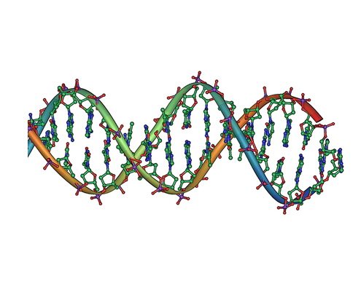
The Bioventus Sales DNA for Success
When interviewing for talent at Bioventus it has been proven that the most successful individuals are those that have the following advanced competencies as part of their DNA.
These 4 things are what we will use going forward to drive the Employer Hiring Brand for Sales at Bioventus!
Sales Drive -Has drive and enthusiasm, seems hungry for success, and propels oneself to meet tough targets.
Emotional Intelligence - Having the ability to identify and understand other people's emotions, and the desire to respond to them productively.
Adaptability - Identifies and adopts the most appropriate style to maximize success in sales situations. Is able to relate to clients or prospects.
Active Listening Skills - Listens sympathetically to others and vigilantly observes and interprets peoples’ behavior

