Slide 1



https://platform.execonline.com/p3/register/42eaa809-4f76-4e74-ab49-eb3689cd22d7
Notes:
So lets go back to the EXECONLINE offering and learn what is available for you

Slide 2


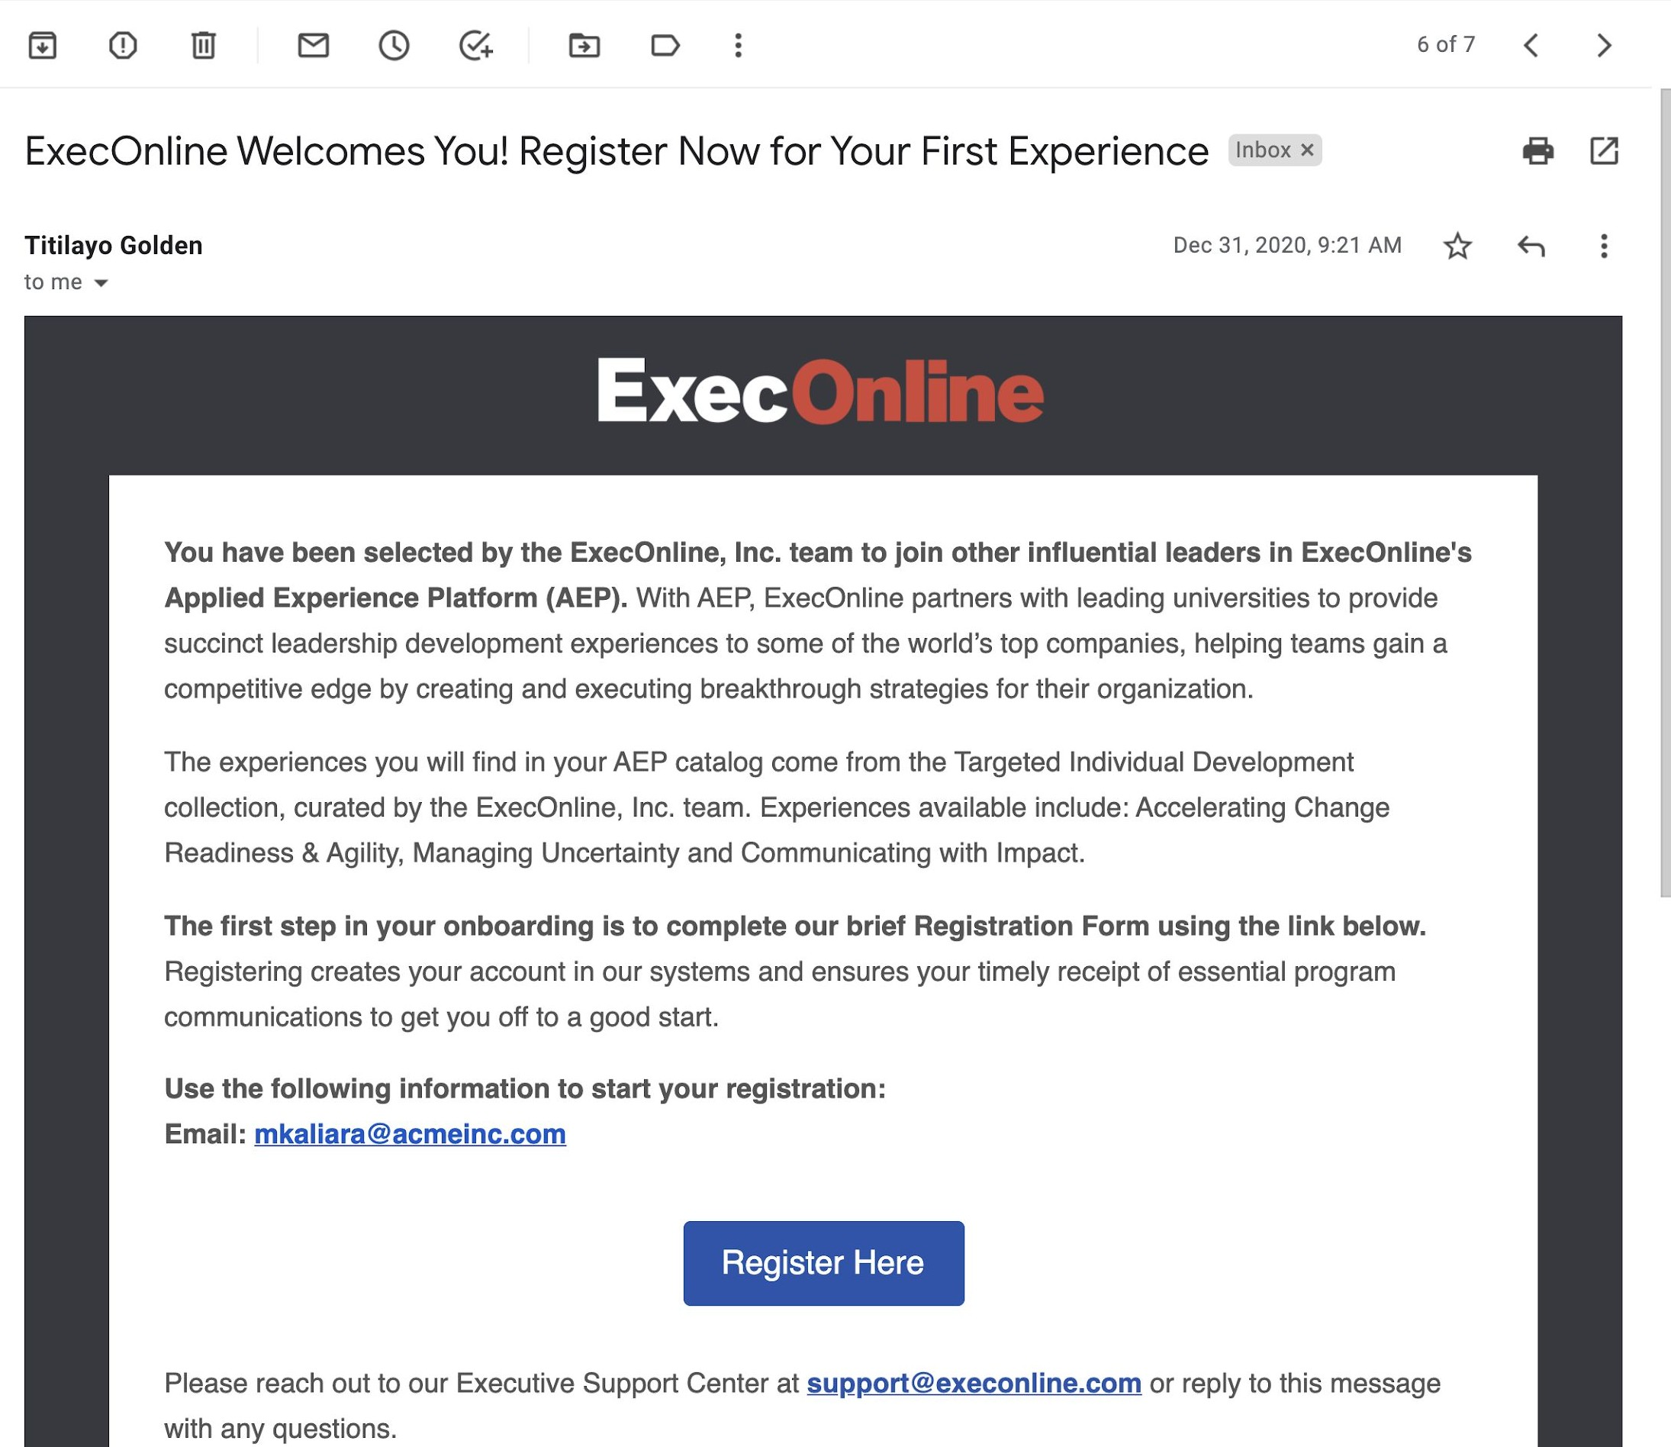
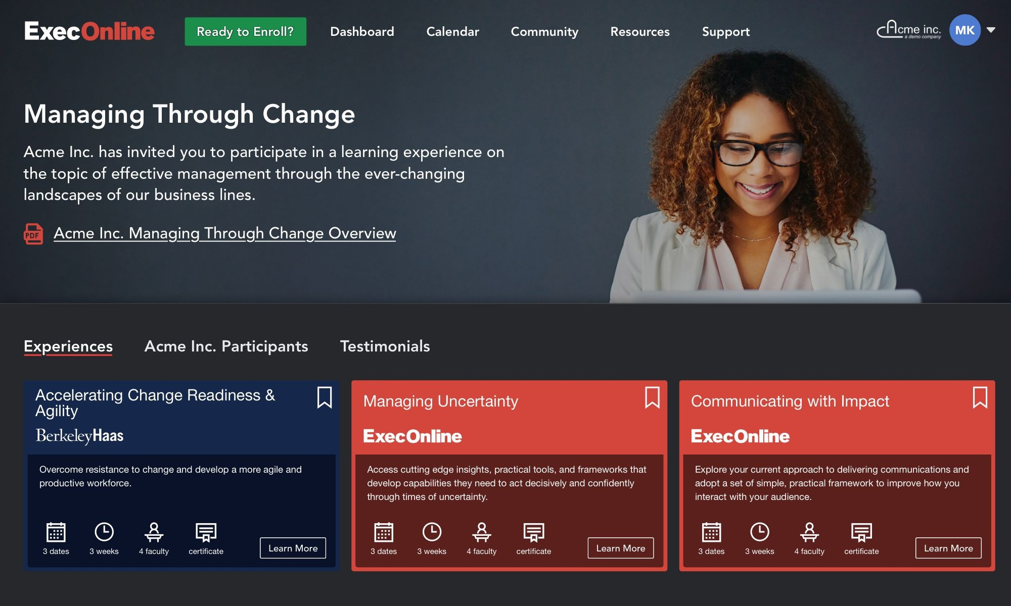
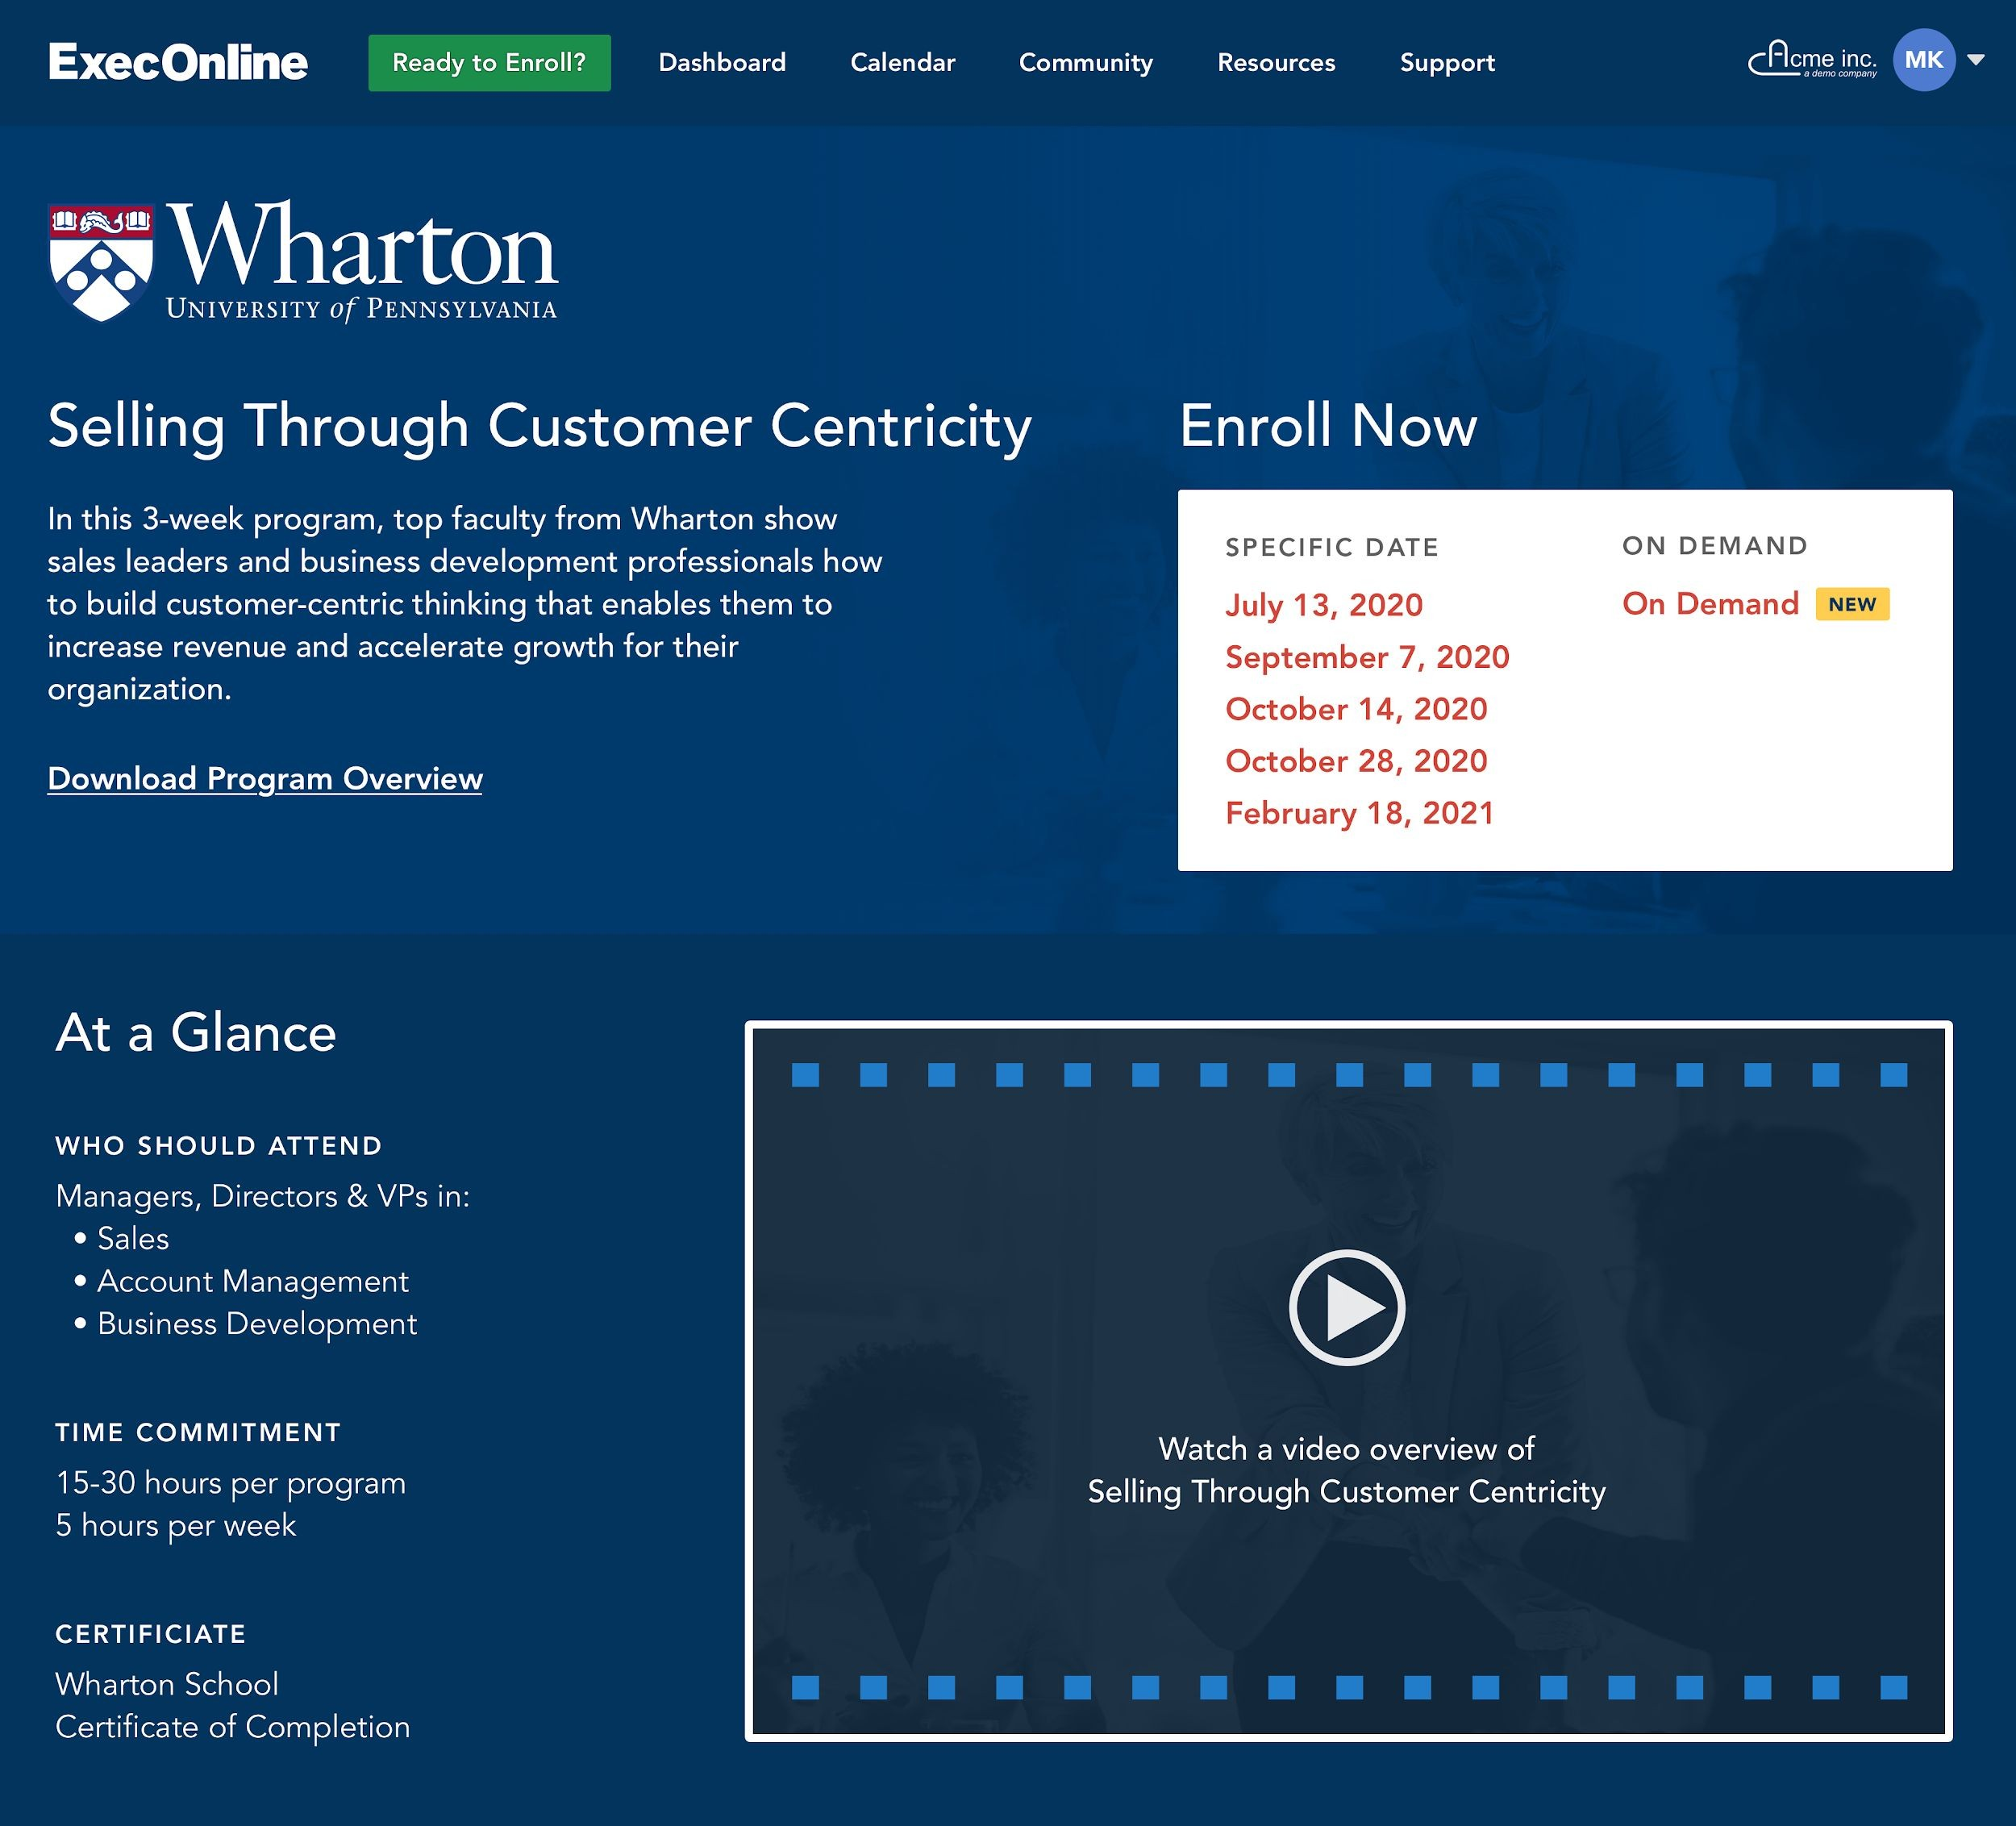
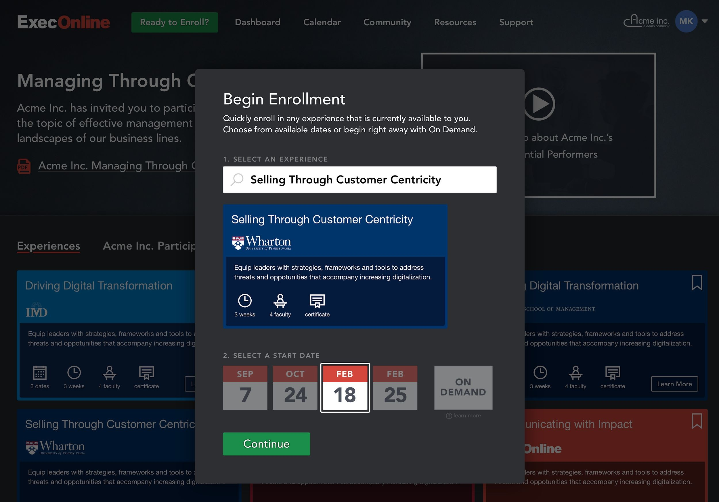
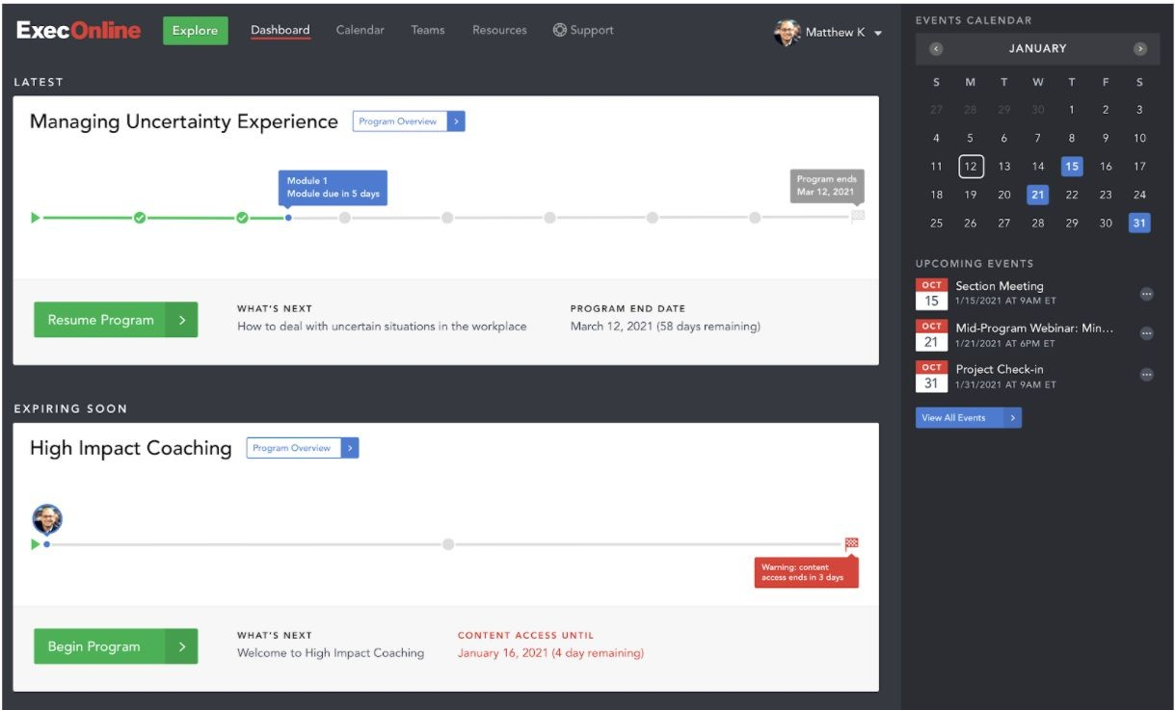
How does it work?
Visit https://platform.execonline.com/p3/register/42eaa809-4f76-4e74-ab49-eb3689cd22d7 and explore all the different
Training Programs Bioventus University has to offer and register using
your Bioventus Email Address
Once Registered, you can search for any training of interest and learn
more about the training itself
To ensure you are choosing the right training for your goals watch
previews and choose from course offerings
Choose the date you want to start your program
You will participate and complete your training on the same platform
Notes:
So how does it work or how can you sign up for one or more programs?
Also here we have tried to keep it simple. Now the link you see is not and please know that you don’t have to quickly copy or write this one down.
But through the link we will send to you shortly you will be directed to a special Bioventus University page on the execonline platform.
To access you need to register with your Bioventus email and create your own personal password.
Once completed you will see a page on which all of the available programs are listed. So have a look around and explore what training fits your goals. Remember, you can sign up for one course at the same time and you have to complete the course before your next one.
By selecting the training of your choice you can select the desired start date and get ready to start. You will start and complete your traininsg on the same platform what has been found quite user friendly.
<NEXT SLIDE>

Slide 3












Available programs
BUSINESS TRANSFORMATION | PRACTICING LEADERSHIP | WOMEN IN LEADERSHIP | COMING IN H1 2021
Implementing Winning Strategies 3 WEEK EXPERIENCE | LEARN MORE | Fostering Inclusion & Diversity 3 WEEK EXPERIENCE | LEARN MORE | Embracing a Growth Mindset 1 WEEK EXPERIENCE | LEARN MORE Cultivating Collaborative Leadership 1 WEEK EXPERIENCE |LEARN MORE Developing Equity Fluent Teams 1 WEEK EXPERIENCE | LEARN MORE | Leveraging Different Perspectives 1 WEEK EXPERIENCE Adapting to Changing Contexts 1 WEEK EXPERIENCE
Accelerating Change Readiness & Agility 3 WEEK EXPERIENCE | LEARN MORE | Communicating Persuasively & Building Trust 1 WEEK EXPERIENCE | LEARN MORE Optimizing Self-Awareness 1 WEEK EXPERIENCE | LEARN MORE
Selling Through Customer Centricity 3 WEEK EXPERIENCE | LEARN MORE |  |  | Maximizing Operational Effectiveness 3 WEEK EXPERIENCE
Driving Digital Transformation 3 WEEK EXPERIENCE | LEARN MORE | Strengthening Workplace Wellness 3 WEEK EXPERIENCE | LEARN MORE Achieving Mental Flow & Thriving 1 WEEK EXPERIENCE | LEARN MORE Building Resilience & Preventing Burnout 1 WEEK EXPERIENCE | LEARN MORE Enhancing Team Wellbeing 1 WEEK EXPERIENCE | LEARN MORE |  | Leader as Coach THREE 1 WEEK EXPERIENCES
Communicating With Impact 1 WEEK EXPERIENCE | LEARN MORE Managing Uncertainty 1 WEEK EXPERIENCE | LEARN MORE Managing Virtually 1 WEEK EXPERIENCE | LEARN MORE |  |  | Business Finance Fundamentals 3 WEEK EXPERIENCE
Notes:
Here you see an overview of all of the current available programs and their business schools. Together with ExecOnline we are constantly expanding the number of programs for you. I expect that by the end of 2021 we have added at least 15 new programs to this overview.
So who of you always wanted to participate in a program of these business schools?

Slide 4
Fostering Inclusion & Diversity
Yale School of Management

Slide 5


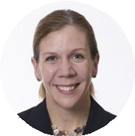
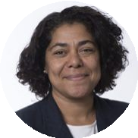
Fostering Inclusion & Diversity
Experience Overview
Fostering Inclusion and Diversity equips leaders with the skills to build more diverse teams within more inclusive environments to increase collaboration, innovation, and overall effectiveness. By establishing new perspectives regarding teamwork, leadership, and how to leverage the collective strengths and perspectives of others, participants will make better business decisions while promoting positive cultural change within their organization.
Understand how to overcome bias to better engage with people of different backgrounds and experiences, enabling better business decisions
Increase the diversity of perspectives you solicit by understanding the similarities and differences within your regular network of decision inﬂuencers
Improve team members’ performance by creating an inclusive team dynamic that fosters consideration over a wider range of perspectives
AMY WRZESNIEWSKI
HEIDI BROOKS
Copyright © 2020 ExecOnline, Inc. All Rights Reserved.
5

Slide 6
Fostering Inclusion & Diversity
Key Conceptual Models
✔ Redeﬁning "Leadership”: Generate a different perspective regarding the role and goals of a leader, and how to best meet the organization's expectations for performance.
✔ Promoting Behavioral Change: Implement behavioral, process, and cultural norm changes that encourage individuals to move from a perspective of compliance (actions based on rules, rewards, and punishments) toward internalization (actions based on inherent merits and beliefs).
✔ Biases: Acknowledge and actively manage the biases each of us hold that blocks personal and team performance.
✔ Dimensions of Diversity: Recognize the multitude of “differences” that exist in any group, beyond age, race, and gender, that can be leveraged to generate new insights and enhance team performance.
✔ Reinforcing Patterns of (Dis)Engagement: Identify how common patterns of behavior and presumptions can create reinforcing cycles of dis/engagement and de/motivation.
✔ Marketplace Perceptions: Build awareness of how internal inclusion and diversity efforts and attitudes are reﬂected in customer and general public views of your company.
✔ Model Key Behavioral Learnings: Translate new skills into real-life behaviors through modeling sessions.
6

Slide 7
Fostering Inclusion & Diversity
Curriculum: Week by Week
MODULE LECTURES [VIDEOS]
KEY LEARNING
One: Inclusion, Diversity, & Biases Video Lectures: 85 Minutes Assignments: 75 Minutes
The Nature of Biases
Biases in Social Networks
Implicit Bias
Bias’ Impact on Decision Making
Stages of Diversity
Barriers to Discussion
Leadership Choices
Effectiveness: Impact & Intention
A Learning Mindset
Effective Interviewing
This module focuses on opening your thinking about the nature of inclusion, the impact of diversity on individual and interpersonal processes and the role biases play in your daily actions and decision-making. Implicit bias is also discussed as a powerful inﬂuencing factor in your interactions with others. You will reﬂect on how these topics relate to you as an individual, as well as a leader within your business unit, team, and organization.
Two: Interpersonal & Group Processes Video Lectures: 75-80 Minutes Assignments: 90-120 Minutes
Live Virtual Events: 60 Minutes
Group Decision Making
Active Listening
Improving Active Listening
Emotionally Intelligent Inclusion and Belonging
Interpersonal Communication
Closing the Gap between D&I Aspirations and Reality
Inclusion Barriers: Psychological Safety
Inclusion Barriers: Justice
In this module, focus broadens from individual biases to address how inclusion, bias, and decisioning play out at the interpersonal and group level. You will learn about the key components of Group Decision Making, how to become a better active listener, and how having a strong emotional intelligence will enable you to have the often difﬁcult conversations related to inclusion and diversity. Lastly, techniques to removing common barriers to healthy and effective inclusion efforts will be introduced, emphasizing psychological safety and fairness/organizational justice.
Three: Inclusive Decision Making Video Lectures: 65-70 Minutes Assignments: 60 Minutes
Group Collective Intelligence
Group Inclusive Practices
Power and Politics in Organizations
Building Inclusion Allies
Culture Change Tips
Addressing Inevitable Obstacles
With an understanding of how inclusivity and biases relate to you, as an individual, and to your interactions with others in small and large group settings, this module hones in on how to leverage this knowledge to create more inclusive decision-making processes within your teams and organization. You will learn the elements of Group Collective Intelligence and how they can be incorporated into effective group inclusive practices. Strategies related to how to consider the sensitive topics of power, coalition building, and culture change to increase adoption of new inclusion practices are also covered.
* Module = 1 Week **Live Events may be subject to change
NOTE: Orientation Pre-Requisite Work (90 minutes) and Final Presentation at end of experience (90 minutes).
7

Slide 8
Fostering Inclusion & Diversity
Assignments & Activities
MODULE 0: CURRENT STATE REFLECTION
Choose a decision that is pending, along with those you plan to engage for discussion and ideas
Reﬂect on your view of your role as a Leader, related to this decision
Project Selection Aid
MODULE 1: SET UP CONVERSATIONS (OPEN UP YOUR NETWORK)
Identify other individuals who may have something to contribute in the decision-making process, but were not originally targeted for engagement
Workgroup Diversity Survey
MODULE 2: CONDUCT & SUMMARIZE CONVERSATIONS (UNCOVER NEW INSIGHTS)
Conduct conversations with the newly targeted individuals and note new/novel insights regarding pending decision that would have otherwise been missed
MODULE 3: PLAN MEETING (ENGAGE AND IMPROVE)
Plan a meeting with original and new individuals to collectively discuss the pending decision, using newly acquired tactics to encourage inclusive participation and engagement
Meeting Dramatization Critique

Slide 9
Fostering Inclusion & Diversity Project Examples
NAME DESCRIPTION |  | PROJECTED BUSINESS IMPACT |  | PROJECTED FINANCIAL IMPACT
Data Analytics for The Head of Corporate Audit and Advisory at a |  | Increased Employee |  | $100,000
Audit, Risk & transportation company worked toward a decision to |  | Productivity 10%
Compliance determine if his organization needed a dedicated data
analytics team.
Employee Employee engagement scores decreased signiﬁcantly at a |  | Increased Employee |  | $2,500,000
Engagement healthcare organization in 2017, leading to increased |  | Retention 5%
turnover. A Senior Director of HR implemented an initiative
to increase the diversity of the workforce, improving overall
employee morale and engagement.
Merger Employee To achieve a successful business merger, a District Sales |  | Increased Employee |  | $200,000
Retention Manager developed a plan to better incorporate new |  | Retention 100%
employees into his organization.
Polaris Workﬂow As part of developing a new product, a Vice President of |  | Increased Employee |  | $20,000,000
Finance for a telecommunications company developed a |  | Retention 10%
plan to standardize their customers' project workﬂow.
Senior Sales A National Account Manager developed a plan to implement |  | Increased Employee |  | $20,000,000
Orientation a training experience for his organization's emerging senior |  | Retention 25%
sales managers, with the goal of eliminating a complex
learning curve.

Slide 10
Accelerating Change Readiness & Agility
UC Berkeley Center for Executive Education

Slide 11





Accelerating Change Readiness & Agility
Experience Overview
Today’s executive must master the ability to adapt and transform in a ﬂuid, competitive world. Flexibility is essential. In Accelerating Change Readiness & Agility, Homa Bahrami, a senior lecturer at UC Berkeley’s Haas School of Business, guides you to transform the way you organize, lead, interact, and drive change continually. In this engaging and transformative experience, you will discover your receptiveness to change and aptitude for driving change (“Adaptive DNA”) and learn about the key capabilities demonstrated by successful change leaders. You will work through actual workplace challenges, including diagnosing and leveraging your organizational culture, and become better equipped to swiftly react to and implement real change at the individual and team levels. Be a catalyst for change.
Develop and apply 5 key adaptive competencies: robustness, resilience, hedging, agility and versatility
Understand how culture impacts change management and develop strategies to navigate and shape it
Create "super-ﬂexible" teams in the face of uncertainty
Develop your personal agility, build your team's capabilities, and shape your organizational environment
Avoid analysis paralysis and accelerate decision-making speed
Assess and understand your "adaptive DNA"
Align your department's culture with your strategic objectives
JENNIFER CHATMAN
HOMA BAHRAMI
JO-ELLEN POZNER

Slide 12
Accelerating Change Readiness & Agility
Key Conceptual Models
✔ Adaptive DNA: Competencies that enable successful leaders to deal with unexpected changes: Robustness, Resilience, Hedging, Agility and Versatility.
✔ Organizational / Strategic Culture: The system of norms and values that engender long-term adaptability; related assessment tools.
✔ The Adoption “S” Curve and Stakeholder Segmentation: Principles for identifying sympathetic stakeholders in order to maximize inﬂuence and persuasion.
✔ The Change Readiness Playbook: An adaptable framework for ﬂexible change planning and implementation.
Additional Experience Features
✔ Personal Assessment: Individualized “Adaptive DNA” assessments pinpoint critical gaps and improvement opportunities across ﬁve key dimensions: Robustness, Resilience, Hedging, Agility and Versatility.
✔ Interactive Media:
“Needs More What?” provides practice in identifying the adaptive competencies required to address common situations.
“Stakeholder Segment Exercise” challenges participants to identify key types of stakeholders in order to maximize inﬂuence and persuasive power.
✔ Video Case Study: Illustrates essential aspects of the Change Readiness Playbook in action.

Slide 13
Accelerating Change Readiness & Agility
Curriculum: Week by Week
MODULE LECTURES [VIDEOS] KEY LEARNING
One: Learn & Prepare Video Lectures: 60 Minutes Assignments: 1-2 Hours
Leading in a Fluid World
Silicon Valley: Our Research Lab
“Adaptive DNA” and Individual Change Readiness (Robustness, Resilience, Hedging, Agility, Versatility)
You will take a brief Adaptive DNA assessment to understand your personal strengths and development opportunities. In this Module, Professor Bahrami will provide foundational concepts for understanding leadership agility. With guidance, you will identify a critical challenge to work on across the experience, and will create personal plan to leverage Adaptive DNA.
Two: Diagnose & Engage Video Lectures: 60 Minutes Assignments: 30-45 Minutes Live Virtual Events: 60 Minutes
Motivating Change
Encouraging Risk Taking
Implementing Change
Diffusion of Change
Segmenting Stakeholders for Implementation
Professors Chatman and Pozner will show you how to diagnose organizational and cultural barriers to change. You will learn how to promote collaboration and risk taking as well as strategies for communication. You will apply these ideas to your personal case through an organizational diagnosis and stakeholder segmentation.
Three: Experiment & Iterate Video Lectures: 60 Minutes Assignments: 30-45 Minutes
Barriers to Execution (Hard and Soft Factors)
The Scientiﬁc Approach
Your Change Readiness Playbook
Communicating Your Ideas
Develop your change readiness playbook. Professor Bahrami provides tools for overcoming barriers to execution. She will share how to use a ‘test and learn’ approach. With guidance, you will create a change readiness playbook for your personal case.
* Module = 1 Week **Live Events may be subject to change NOTE: Orientation Pre-Requisite Work (30-45 minutes).
13

Slide 14
Accelerating Change Readiness & Agility
Project Examples
NAME |  | DESCRIPTION |  | PROJECTED BUSINESS IMPACT |  | PROJECTED FINANCIAL IMPACT
Changing Target |  | With operations and processing capabilities having been |  | Increased Employee |  | $20,000,000
Operating Model |  | historically under-invested in, an Operations Head for a ﬁnancial |  | Productivity 30%
 |  | services ﬁrm made the business case to invest in digitizing the
 |  | business front-to-back to drive overall productivity.
Cloud Migration |  | Following an assessment that revealed critical process |  | Increased Efﬁciency 30% |  | $250,000
Project |  | improvement opportunities, a Senior Director of Business
 |  | Applications from a healthcare company launched a cloud
 |  | migration initiative for one of the organization's core systems.
Continuous Finance |  | While continuously analyzing and improving performance, a |  | Increased Customer |  | $6,000,000
Improvements |  | Director of Finance from a semiconductors business implemented |  | Loyalty/Satisfaction 15%
 |  | a strategy to reduce the time spent on manual work.
Department Culture |  | Faced with a toxic culture from long-time employees, a Director |  | Increased Quality 60% |  | $1,000,000
Change |  | of Training Administration for a consumer services company
 |  | introduced assessments and metrics along with KPIs that
 |  | individuals now participate in achieving to shift the overall team
 |  | dynamic.
Shifting Development |  | A Vice President for a major ﬁnancial services institution |  | Increased Quality 60% |  | $200,000
Operations |  | successfully shifted the operations responsibilities from her
 |  | technology team to allow them to focus more on development
 |  | and improving their overall expertise.

Slide 15
Driving Digital Transformation
IMD Business School

Slide 16


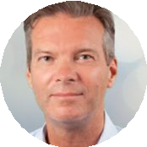
Driving Digital Transformation
Experience Overview
Driving Digital Transformation equips leaders with strategies, frameworks, and tools to address the threats and opportunities that accompany the increasing digitization of business models, products, and value chains. Participants in this experience will develop a clear roadmap of how they need to go through their transformation journey for their company in the context of their industry.
Establish a strong awareness of the driving reasons why transformation is necessary to respond to growing digital changes
Identify a clear and appropriate strategic response for those business elements identiﬁed to have high impact (opportunity or threat) that creates the greatest market differentiation
Improve leader awareness, decision making, and execution speed while creating a roadmap for expanding digitization across the organizational value chain
MICHAEL
R. WADE

Slide 17
Driving Digital Transformation
Key Conceptual Models
✔ Digital Vortex: A metaphorical model of the impact severity felt by various industries due to digital transformation.
✔ Sources of Customer Value: The three main types of customer value delivered by digital disruptors: Cost, Experience, and Platform value.
✔ Digital Disruption Response Strategies: The offensive (Disrupt / Occupy) and defensive (Harvest / Retreat) strategies that can be used when facing digital disruption.
✔ Digital Business Agility: The three individual and organizational capabilities required to survive and thrive in disruptive times and environments: Hyperawareness, Informed Decision Making, and Fast Execution.
✔ Digital Orchestra: A conceptual structure to help identify the various cross-organization resources that should be mobilized to enable a digital response plan.
Additional Experience Features
✔ Digital Vortex Survey: An evaluation tool to deﬁne one’s current location within the Digital Vortex and compare that position with other members of the experience cohort.
✔ Interactive Media:
“Response Strategy Selection Tool” is a questionnaire aimed at assessing the current state of a line of business to identify the best offensive or defensive response strategy.
“Digital Orchestra Structure and Resources” is an exploration resource that provides detailed information behind the key components of the Digital Orchestra concept.
✔ Disruptive Business Models for Customer Value Job Aid: A resource for jumpstarting business model ideas for successfully creating customer value.
✔ Sample Assignment Deliverables: Model ﬁctional deliverables that serve as illustrative examples of high-quality ﬁnished assignment submissions.
■
■

Slide 18
Driving Digital Transformation
Curriculum: Week by Week
MODULE LECTURES [VIDEOS]
KEY LEARNING
One: Thriving in the Digital Vortex Video Lectures: ~60 mins Assignments: ~60 mins
The Digital Vortex and Digital Disruption
Companies & Digital Disruption
Intro to Value Drivers
Uber Bus. Model and Cost Value
Value Vampires & Vacancies
Internet Giants
Google/Facebook/Amazon/Alibaba/ Tencent
This module focuses on establishing an understanding of the market factors behind the push to digitalization and a motivation for actively engaging in the transformational response that will be required to survive in this new competitive environment. The module will include information related to key value drivers and industry examples of organizations that have dominated the Internet.
Two: Digital Disruption Strategy Video Lectures: ~45 mins Assignments: ~60-90 mins
Live Virtual Events: 60 Minutes
Responses to Disruption
Harvest & Retreat
Disrupt & Occupy
Value Drivers and Responses
Ex: Napster/Dollar Shave Club
Leading Amid Disruption
Humble & Adaptable
Visionary & Engaged
Transformation Journey Examples
This module concentrates on the different approaches to digital disruption, either as a disruptor or in response to a disruption by a competitor. Additionally, the module includes information related to navigating and overcoming the challenges leaders face during the transformations that accompany digital disruption.
Three: Digital Adaptation and Execution
Video Lectures: ~60 mins Assignments: ~90-120 mins
Digital Business Agility
Hyperawareness
Informed Decision Making
Fast Execution
The Digital Orchestra & Org Resources
Ex: GE/Insurance Industry
Digital Disruption: Bringing it Together
The Fujiﬁlm Story
The ﬁnal module concludes the experience with an overview of the three key components of digital business agility – capabilities necessary to survive and thrive in disruptive times. Finally, a conceptual tool – the Digital Orchestra – is introduced to help bring together the experience’s key elements for practical execution in addressing real-world challenges.
* Module = 1 Week **Live Events may be subject to change
NOTE: Orientation Pre-Requisite Work (90 minutes) and Final Presentation at end of experience (90 minutes).
18

Slide 19
Driving Digital Transformation
Project Examples
NAME DESCRIPTION
PROJECTED BUSINESS IMPACT
PROJECTED FINANCIAL IMPACT
Worksite Beneﬁt Service Logistics Transformation
A Director of Acquisition Strategy at an insurance company proposed the development of a technology tool to easily identify agent specialization, expertise, location, and availability to increase revenue through service and sales optimization for their customers, accounts, and broker partners.
Increased Customer Loyalty
$400,000
Transforming Supply Chain Trading
A Senior IT Director at a consumer products company implemented technologies that would allow his team to automate and reduce their reliance on manual data entry and extend the digital experience back into their key suppliers.
Improved Supplier Relationships
$22,500,000
Earn & Win Market through Digital
A Finance Controller at an agriculture company implemented his digital project around Competitor Benchmarking to generate hyperawareness about the organization’s competitors.
Increased Employee Productivity
$600,000
High Wealth Audience Cultivation through Enhanced Digital Experiences
A Chief Development Ofﬁcer at a nonproﬁt organization explored options to leverage technology to complement the relational work of her team, as a pilot, to increase customer value and experience.
Increased Customer Loyalty
$8,500,000

Slide 20
Selling Through Customer Centricity
Wharton School of Business

Slide 21


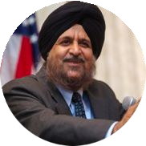


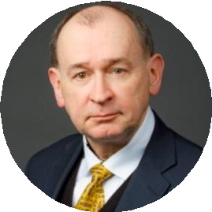
Selling Through Customer Centricity
Experience Overview
Enable sales leaders and professionals to increase revenue and accelerate growth by engaging in strategic customer-centric thinking. In today’s market, traditional product and even solution selling approaches don’t work. Instead, sales professionals require a deeper understanding of their customers, going beyond identifying their customer’s direct needs to uncover what will make them successful, that is, to understand the needs of their customer’s customers. Participants apply learnings to identify their highest-opportunity customers, determine how to strategically support them, and develop impactful sales plans that deliver improved value.
Map your customers’ lifecycle journey from initial exploration through repurchase
Segment your customers or channels to target those who offer the most opportunity based on market behaviors
Translate customer insight into a plan of action to serve as a trusted advisor
Uncover opportunities to develop a shared understanding of how to help your customers achieve their larger goals
Explore multiple paths to growth, including considering incremental product or service improvements that create disproportionate value. Develop a compelling business case to mobilize support
Deﬁne how to position yourself to these customers and identify gaps and opportunities across their purchasing/use lifecycle
JAGMOHAN
S. RAJU
PATTI WILLIAMS
BOB MEYER
DON HUESMAN

Slide 22
Selling Through Customer Centricity
Curriculum: Week by Week
MODULE LECTURES [VIDEOS] KEY LEARNING
One: The Customer Journey
Module: ~75 Minutes
Introduction to Positioning
The Customer Experience
Journey Graphs, Pain Points, and Brand-Based Differences
Using Psychology to Improve Journeys
In Module 1, Wharton’s renowned business school professors will introduce what it means to be “customer-centric” and explain why this mindset is essential for driving growth.
Professor Patti Williams will discuss a paradigm shift in how organizations view their customers, and examine the importance of the “customer journey.” Williams will then introduce tools to help you pinpoint your customers’ needs, goals, and pain points.
Two: Segmentation and Targeting
Module: ~75 Minutes
Live Virtual Events: 60 Minutes
Introduction to Segmentation
Introduction to Targeting
Customer Lifetime Value
In Module 2, you will learn how to set priorities through segmenting your customers. Professor Bob Meyer will introduce a range of techniques—from data intensive methods to more “back-of-the-napkin” approaches—to help you segment your customer base. Professor Meyer will highlight key criteria you can use to prioritize your highest-opportunity customers.
Three: Sales Messaging and Growth Plan
Module: ~75 Minutes
Crafting a Positioning Statement
The Chain Model
Communication and Messaging
You will learn why “positioning” is crucial to effectively meeting customer needs and how to craft a positioning statement for your target customers that articulates the differentiated value you will provide.
To conclude your learning journey, you will learn the Chain Rule, which will help you identify and evaluate opportunities for growth.

Slide 23
Selling Through Customer Centricity
Assignments
MODULE ASSIGNMENT
Orientation
Preparing for Your Customer-Centric Journey
Identify Opportunities for Sales Growth
Review exemplar sales plans
Select your critical issue
One: Customer Experience
Adopt Your Customer's Perspective
Identify What Matters to Your Customers
Map your customer’s journey
(Suggested) Engage with customers to enhance your understanding
Summarize areas of opportunity to inﬂect, including understanding your “customer’s customer”
Two: Segmentation and Targeting
Target Your Highest-Opportunity Customers
Prioritize Key Customers
More effectively segment your customers to target the right opportunities
Evaluate your segments
Select your target segment and summarize their needs
Three: Sales Messaging and Growth Plan
Plan to Exceed Your Sales Targets
Clarify Your Differentiation
Articulate your positioning to deliver differentiated value to your highest-opportunity customers
Develop Your Growth Plan
Summarize current gaps against your proposed positioning
Consider alternative tactics to generating growth
Plan how you will prioritize your efforts to deliver value efﬁciently

Slide 24
Selling Through Customer Centricity
Example Growth Plans
ROLE DESCRIPTION
PROJECTED FINANCIAL IMPACT
PRIORITIZE A CRITICAL SEGMENT
Sales professionals can struggle to identify how to identify their highest-opportunity customers. Use a structured approach to target effort where it generates return.
Division VP, Sales and Strategy - Intelligence and Information Solutions
Identify speciﬁc contract opportunities that present the greatest potential for achieving growth targets aligned with Performance Unit and Business Unit goals. The Sales Delivery Directors will use these opportunities to allocate proposal team resources and deliver compelling proposals.
$2,258,850
MAKE THE CASE FOR A KEY SERVICE EXTENSION
Sales professionals have the most direct view of what customers seek. But they can ﬁnd it difﬁcult to synthesize what they hear into focused and supported business cases for improvements to the offering.
Customer Account Representative
While some customers use our products “as is”, most require some fabrication done. There’s a need for a “one stop shop.” Many customers already have their own fabrication department, but they can’t keep up with their growing markets. We can add fabrication as a new offering. Our equipment will be more efﬁcient to handle the required speciﬁcations, so this win-win fabrication service will produce more revenue for both us and our customers.
$12,000,000
LEAD DEEPER CONVERSATIONS
Sales professionals know how their offerings differ from competitors. But it can be challenging to tease out and radically amplify just those elements that matter most to a targeted segment of high-opportunity customers.
Mid-Atlantic Sales Manager
Our customer faces a large workload to deliver in a short time frame with an inadequate workforce. We will provide top to bottom support to enable them to exceed their structural capacity. We are unique in that we understand and share the values of [customer] to ensure that local residents and local small businesses beneﬁt, but we still have the full-service of a big ﬁrm able to deliver start to ﬁnish and to provide transparency and accountability.
$243,956

Slide 25
Implementing Winning Strategies
Columbia Business School

Slide 26


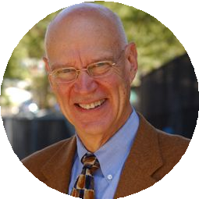
Implementing Winning Strategies
Experience Overview
Implementing Winning Strategies is led by Professor Willie Pietersen, a battle-tested, former Fortune 100 corporate CEO and now celebrated Professor of the Practice of Management at Columbia Business School. The experience empowers you to think systematically about strategy, understand the speciﬁc roles and responsibilities for creating aligned strategies at each level, employ a common language and shared understanding among your team, and cascade strategies through the entire organizational system—all with the aim of “unity of action” driven by true commitment. Master the fundamentals of strategy and get the job done!
Strategy vs. Planning
The 4-Step Strategic Learning Cycle The Winning Proposition
Line of Sight
The Situation Analysis: “Outside-In” Thinking
Strategic Choices
Key Priorities and Closing the Gaps Organizational Priorities
Continual Learning
WILLIAM PIETERSEN
Professor of the Practice of Management
Willie brings a unique mix of real world experience and thought leadership to his work with corporations and executives around Strategic learning and change. Willie served as the CEO of Lever Foods, Seagram USA, and Tropicana and has advised Deloitte, Exxon Mobil, Novartis, and SAP among others during his Columbia tenure. His latest book Strategic Learning, develops the principles and application tools for the Strategic Learning Process, a unique framework for creating and implementing breakthrough strategies.

Slide 27
Implementing Winning Strategies
Key Conceptual Models
✔ The Strategic Learning Process: Professor ✔
Willie Pietersen's four-step process for developing and executing strategy – Learn, Focus, Align, Execute.
The Golden Rules: Professor Pietersen's guidelines and related tactics for effective strategy implementation – Close the Gaps, Align the Business Systems, Develop a Leadership Message, and Overcome Resistance.
✔ Situation Analysis: A structured approach to generating actionable insight that focuses on the “Five Areas of Inquiry” – Customers and Stakeholders, Competitors, Industry Dynamics, the Broader Environment, and the Organization’s Own Realities.
✔ The Five Cs: The characteristics essential to successful strategic leadership – Choices, Clarity, Change, Courage, and Compassion.
✔ Strategic Focus: A decision-making process for deﬁning where to compete and how to win the competition for value in that arena.

Slide 28
Implementing Winning Strategies
Curriculum: Week by Week
MODULE LECTURES [VIDEOS]
KEY LEARNING
One: Strategic Leading and the 5 Areas of Inquiry
Video Lectures: 80 Minutes Assignments: 90 Minutes
The Strategic Learning Process
Interpreting Industry Dynamics
Analyzing Customers and Competitors
The Power of Synthesis
Understand the core concepts of Strategy and how to complete the ﬁrst steps of the Strategic Learning Cycle - conducting a Situation Analysis.
Two: Making Choices and Winning at Value
Video Lectures: 60 Minutes Assignments: 90 Minutes
Live Virtual Events: 60 Minutes
Serving External and Internal Customers
Deﬁning Your Winning Proposition and Key Priorities
Maximizing Your Value-Cost Gap
The Arithmetic of Business & the 3 Bottom Lines
Distill strategic challenges and choices into a Winning Proposition and Key Priorities within the executive span of control.
Three: Strategy Implementation: The Golden Rules
Video Lectures: 80 Minutes Assignments: 90 Minutes
Keys to Successful Implementation
Achieving Business System Alignment
Overcoming Resistance and Driving Momentum
The Five Cs
Identify organizational considerations that must be navigated for the successful implementation of a new Strategy.
* Module = 1 Week **Live Events may be subject to change
NOTE: Orientation Pre-Requisite Work (90 minutes) and Final Presentation at end of experience(90 minutes).
28

Slide 29
Implementing Winning Strategies
Project Examples
NAME DESCRIPTION
PROJECTED BUSINESS IMPACT
PROJECTED FINANCIAL IMPACT
Exceptional HR Service Delivery
Because of a complex HR structure, an HR Manager with a consumer services company restructured her team to better align with the business strategy.
Increased Customer Loyalty/Satisfaction 75%
$100,000
Good to Great
A Head of Service Delivery for a manufacturing company was able to work with internal stakeholders to discover common issues surrounding the company's shared services center.
Increased Customer Loyalty/Satisfaction 20%
$5,000,000
Omni-Channel Experience
With a high volume of expensive voice calls in their call centers, a Vendor Manager from an insurance institution invested in alternate channels for their associates to communicate with members.
Increased Efﬁciency 30%
$50,000
Redeploying Assets
Because of an antiquated asset with limited ability to build more than one product, a Director of Sales for a manufacturing company re-deployed it after the product was discontinued to provide the business with additional return on investment.
Reduced Risk 10%
Currently Measuring
Replacing Yesterday’s HR Technology
An Associate Vice President of HR Information Systems at a ﬁnancial institution made the business case to replace her institutions 16-year-old systems to enable HR to meet the needs of employees and managers.
Increased Employee Productivity 40%
$500,000

Slide 30
Strengthening Workplace Wellness
DUKE CORPORATE EDUCATION

Slide 31

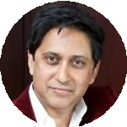
Strengthening Workplace Wellness
Experience Overview
Sustaining a competitive advantage in an environment of sweeping economic change, rapid innovation, and increasing virtualization of the workplace is a demanding challenge for leaders. The ability to thrive in such circumstances through enhanced mental wellness correlates with greater satisfaction, agility, and engagement at work, thereby giving organizations an additional market advantage. Participants will leverage Neuroscientist, Dr. Srini Pillay’s proprietary “Neurocoaching®” framework to develop a personalized mind-body wellness plan. This plan will enable them to adopt the mindset needed to establish a sense of purpose and drive personal and team performance.
Learn how to restore calmness and clarity in times of uncertainty.
Adapt and thrive in the face of uncertainty, rather than just “bouncing back.”
Recognize and manage multiple obstructions to mental wellness that originate in our brains.
Manage stress-provoking and potentially overwhelming circumstances to avoid burnout and enhance wellbeing.
Connect business strategies to an individual and collective sense of purpose.
Use practical neuroscience-based strategies and techniques to manage interpersonal relationships and challenges to team wellness.
Leverage an understanding of brain chemistry to build individual and team agility, intuition, and ﬂow.
Implement speciﬁc mindset strategies needed to adapt to situational change and complexity.
Apply neuroleadership techniques to create a culture of wellness.
SRINI PILLAY
Copyright © 2020 ExecOnline, Inc. All Rights Reserved.
31

Slide 32
Strengthening Workplace Wellness
Curriculum: Week by Week
MODULE LECTURES [VIDEOS] KEY LEARNING
Module One: Build Resilience and Navigate Uncertainty Video Lectures: 80 Minutes Assignments: 90 Minutes
Resilience and Mental Wellness
Refueling through Unfocus
Changing Your Relationship with Worry
Handling Mixed Emotions
Using Self-Talk to Manage Uncertainty
Preventing Burnout
Leading in a Crisis
In this module, participants will learn about factors that impact their resilience and competence. Speciﬁcally, they will learn how to respond more effectively when facing stressors, so they can quickly bounce back from them. They will learn frameworks for taking strategic breaks and speciﬁc self-talk strategies for managing uncertainty and building conﬁdence. As a result, they will be able to redirect more resources to the thinking, decision-making and innovation centers of their brains. They will also explore common high-stress situations and understand how management here differs from the “day-to-day.” Finally, they will learn a powerful daily “brain hack” and mobilize their bodies to optimize energy and focus levels.
Module Two: Achieve Your Peak Performance
Video Lectures: 80 Minutes Assignments: 90 Minutes
Live Virtual Events: 60 Minutes
Switching to “Thrive” Gear
Building a Sense of Possibility
Becoming a Seasoned Mental Juggler
Enhancing Intuition
Developing Mental “Flow”
Enhancing Wellbeing Through Intrinsic Motivation
Participants will learn about factors that can accelerate their mental growth. Speciﬁcally, they will learn how to switch from purely rational brain circuits to more intuitive and possibility-oriented circuits. They will also learn how to develop a strong sense of meaning and purpose, leveraging Ryff’s well being framework and how to operate at the highest levels in their work, using a framework called “positive disintegration.” Finally, they will round out their mind-body regimen with this newfound sense of possibility and self-belief.
Module Three: Enhance Team Productivity and Creativity Video Lectures: 80 Minutes Assignments: 90 Minutes
Managing Confrontation vs. Compassion
Balancing Bottom-Liners and Possibility Thinkers
Dynamic Listening
Authenticity vs. Discretion
Enhancing Psychological Safety
De-stressing Negotiation
Participants will learn about internal and external factors that impact their social wellbeing. Speciﬁcally, they will learn neuroscience techniques on how to develop superior teams by managing interpersonal tensions and overcoming common challenges to team collaboration and alignment. Participants will learn frameworks they can leverage to manage their reactions to typical interpersonal challenges, in order to respond productively and enhance team harmony and wellness. Finally, they will continue to learn about the mind-body connection to enhance strength, ﬂexibility and compassion.

Slide 33
Strengthening Workplace Wellness
Assignments
MODULE ASSIGNMENT
Orientation
Pre-work: Identify Your Growth Challenge
Identify an initiative or workstream that is both critical to achieving business goals and demonstrates opportunities to optimize performance related to mental wellness.
During the experience, participants create a comprehensive plan to address that challenge (their “Wellness Workplan”).
Module One: Build Resilience and Navigate Uncertainty
Reframe and Refuel for Optimal Resilience
Assess situations related to their Growth Challenge where they and their team have encountered negative feelings or concern.
Apply resilience techniques such as special types of “reframing” to those situations to better endure disappointment or uncertainty, resulting in longer-term resilience and mental endurance.
Mind-Body Connection: Participants plan and experiment with a system of physical and meditative exercises geared to enhance energy and focus. As they proceed through the experience, they’ll track the effects of this regimen on themselves and their team.
Module Two: Achieve Your Peak Performance
Plan to Thrive
Articulate opportunities for thriving related to their Growth Challenge and identify obstructions.
Use the technique of “positive disintegration” to enable themselves and their team to overcome these obstacles.
Mind-Body Connection: Participants expand their mind-body regimen with strategies focused on discovering a sense of possibility and self-belief.
Module Three: Enhance Team Productivity and Creativity
Enhance Team Synchrony
Analyze their team landscape to identify intrapersonal and interpersonal factors that are preventing optimal performance.
Narrow their list to focus on those where improvement tactics would most contribute to the success of their Growth Challenge.
Assess progress made on their Growth Challenge during the experience, and identify additional opportunities beyond their Growth Challenge to continue their development trajectory.
Mind-Body Connection: Participants round out their mind-body regimen with exercises and techniques for enhancing strength, ﬂexibility, and team alignment.

Slide 34
Maximizing Operational Effectiveness
MIT

Slide 35

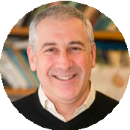

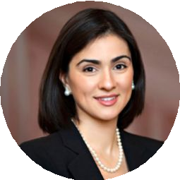
Maximizing Operational Effectiveness
Experience Overview
Operations and non-Operations leaders must ensure that their organizations’ products and services meet or exceed their customer's expectations and that their businesses have the best working environments and processes. In Maximizing Operational Excellence, senior faculty from the MIT Sloan School of Management guide you through proven frameworks for analyzing existing processes, measuring their capacity and effectiveness, and leading the implementation of process improvements. Participants from a broad range of industries and functions will beneﬁt from this high-impact leadership development experience.
Learn how to diagram and accurately depict process structures and ﬂows
Reengineer processes to better serve your customer
Eliminate costly bottlenecks
Reduce costs by optimizing human capital allocation
Implement a high-performance work design Balance standardization and empowerment Increase focus in what is offered to customers
Quantitatively analyze business process
Develop a shared foundation for process optimization and improvement
CHARLES FINE
VIVEK FARIAS
ZEYNEP TON
Copyright © 2020 ExecOnline, Inc. All Rights Reserved.
35

Slide 36
Maximizing Operational Effectiveness
Key Conceptual Models
✔ Process Flow Diagramming: Schematic tools for visualizing and analyzing operational processes.
✔ Business Process Physics: Professor Vivek Farias provides tools and techniques for analyzing process capacity, throughput, and wait times, as well as strategies for predicting performance and contending with unpredictable variability.
✔ The Good Jobs Strategy: Professor Zeynep Ton’s leading-edge approach to work design that focuses on
striking the optimal balance between Standardization and Empowerment and where appropriate, supporting those choices with Cross-Training and stafﬁng with “Slack.”
Additional Program Features
✔ Self-checks: Interactive exercises provide practice in and conﬁrm understanding of key concepts, including measuring capacity, computing throughput, build-up diagrams, process ﬂow analysis, applying the Newsvendor model.
✔ Case Studies: Analyses of leading companies (e.g. Toyota, McDonalds, CVS, Mercadona) in a variety of industries provide illustrative examples of operations concept and process re-engineering approaches.

Slide 37
Maximizing Operational Effectiveness
Curriculum: Week by Week
MODULE LECTURES [VIDEOS] KEY LEARNING
One: Process Analysis Video Lectures: 78 Minutes Assignments: 60 Minutes
Process Flow Diagrams
Order Fulﬁllment and Production Control
Capacity Utilization
Process Diagnosis, Engineering and Principles
Participants will review an existing process and use a process ﬂow diagram to accurately depict the structure and ﬂows. This diagram will be used to promote shared understanding and provide a foundation for process optimization and improvement.
Two: Analysis of Capacity Video Lectures: 96 Minutes Assignments: 30 Minutes Live Virtual Event: 60 Minutes
Getting Capacity Right
Business Process Physics
Unpredictable Variability
Non-Linear Magic
This week's module enables participants to develop a quantitative understanding of input rates, processing rates, throughput, and capacity, as well as the capability to display this information graphically.
Three: Operational Leadership Video Lectures: 68 Minutes Assignments: 90 Minutes
Excellence through Design and People
The Good Jobs Strategy
Four Elements of Work Design
Values-Based Operations
Participants will understand how to implement a
high-performance work design and invest in people to support an optimized system.
* Module = 1 Week **Live Events may be subject to change

Slide 38
Maximizing Operational Effectiveness
Assignments & Activities
MODULE 0: PRE-WORK
Identify three to four processes at your organization that might beneﬁt from analysis and improvement. This assignment will spur your thinking about what a process “is,” and will give you a head start on the personal case project.
MODULE 1: DIAGRAM A PROCESS AT YOUR ORGANIZATION
Select a single, appropriate process at your own organization and diagram it with standard ﬂowcharting software.
MODULE 2: QUANTITATIVELY ANALYZE THE CAPACITY OF YOUR PROCESS
In this assignment, you will put some numbers against the elements of your process and examine throughput. Estimate input rates and all maximum processing rates for each task/resource in your process, and determine maximum possible throughput rate. Optionally, also compute capacity utilization.
MODULE 3: DESIGN A PROCESS IMPROVEMENT
Describe a process problem, including impact and causes, and then propose a solution and support it with evidence from a process analysis.
Complete a Word Design assessment, identifying current states and future target states.

Slide 39
Building Resilience & Preventing Burnout
DUKE CORPORATE EDUCATION

Slide 40

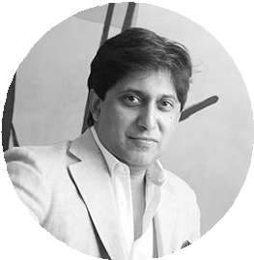
Building Resilience & Preventing Burnout
1 Week Experience
In an environment of perpetual change and volatility, maintaining performance is critically dependent upon the ability to recover quickly from the unexpected. Without a thorough strategy to develop and maintain resilience, leaders are at a far greater risk of burnout.
Estimated Time Commitment: 2.5-3 hours
Faculty Video Lectures: 30 Minutes Create Action Plan: 75-90 Minutes Interactive Activities: 45-60 Minutes
This 1-week experience featuring Dr. Srini Pillay introduces a variety of easy-to-implement strategies for developing resilience and avoiding burnout at work. Participants will identify opportunities to enhance their resilience and then select and plan to implement speciﬁc techniques that will help them build their capacity to respond quickly and effectively to any challenge.
Key Learnings
Refueling for Greater Resilience
Resetting Your Relationship with Worry
Expressing Yourself to Protect Yourself
Dealing with Mixed Emotions
Acting to Prevent Burnout
Faculty Director: Dr. Srini Pillay
Dr. Srini Pillay is the CEO of NeuroBusiness Group, a company that specializes in developing transformational leaders and has been voted one of the Top 20 “movers and shakers” in leadership development in the
SRINI PILLAY
world by Training Industry. He is an internationally recognized expert in applied brain science and human behavior.
Assignment Details: Create an Action Plan
Identify Potential Threats to Resilience
Plan and Implement Your Intervention
Reﬂect and Consider What’s Next
40
Copyright © 2020 ExecOnline, Inc. All Rights Reserved.

Slide 41
Achieving Mental Flow & Thriving
DUKE CORPORATE EDUCATION

Slide 42

Achieving Mental Flow & Thriving
1 Week Experience
When faced with change, uncertainty, and challenge, many leaders ﬁnd themselves prone to underlying fears and anxieties that prevent them from achieving their peak performance. While many leaders try to “bounce back” from adversity, they struggle to truly thrive.
Estimated Time Commitment: 2.5-3 hours
Faculty Video Lectures: 30 Minutes Create Action Plan: 75-90 Minutes Interactive Activities: 45-60 Minutes
This 1-week experience featuring Dr. Srini Pillay provides a new approach with practical tools to develop the leader’s ability to adapt amid challenges. Participants will develop practical ways to accelerate their mental growth and become equipped to obtain a newfound sense of purpose that enables adversity to fuel, rather than inhibit, their best work.
Key Learnings
The Power of Possibility Thinking
Overcome Obstacles to Possibility Thinking
Become a Seasoned Mental Juggler
Develop Mental “Free Flow”
Improve Insight through Meditative Practices
Find Your “I” to Discover Your “Why”
Faculty Director: Dr. Srini Pillay
Dr. Srini Pillay is the CEO of NeuroBusiness Group, a company that specializes in developing transformational leaders and has been voted one of the Top 20 “movers and shakers” in leadership development in the
SRINI PILLAY
world by Training Industry. He is an internationally recognized expert in applied brain science and human behavior.
Assignment Details: Create an Action Plan
Target Roadblocks to Possibility Thinking
Deﬁne Your Energized Purpose
Plan to Thrive by Redeﬁning Your Mental Approach
42
Copyright © 2020 ExecOnline, Inc. All Rights Reserved.

Slide 43
Enhancing Team Wellbeing
DUKE CORPORATE EDUCATION

Slide 44

Enhancing Team Wellbeing
1 Week Experience
When team members feel empowered to contribute freely to team activities and are greeted with a sense that their contributions are valued, the team thrives. However, common interpersonal challenges can hamper that sense of freedom at the expense of productivity, creativity and overall wellness.
Estimated Time Commitment: 2.5-3 hours
Faculty Video Lectures: 30 Minutes Create Action Plan: 75-90 Minutes Interactive Activities: 45-60 Minutes
In this 1-week experience, participants will learn neuroscience-based techniques geared to navigate interpersonal tensions and overcome common challenges to team alignment. Participants will learn frameworks they can leverage to manage their reactions to typical interpersonal challenges, in order to respond productively and enhance team harmony and wellness.
Key Learnings
Why Psychological Safety Is Important for Mental Wellness
Establish Psychological Safety through Authenticity
Deal with Passive Aggression
Avoid GroupThink
Enhance Team Synchrony
Balance Bottom-Line and Possibility Thinking
Faculty Director: Dr. Srini Pillay
Dr. Srini Pillay is the CEO of NeuroBusiness Group, a company that specializes in developing transformational leaders and has been voted one of the Top 20 “movers and shakers” in leadership development in the
SRINI PILLAY
world by Training Industry. He is an internationally recognized expert in applied brain science and human behavior.
Assignment Details: Create an Action Plan
Diagnose Threats to Your Team’s Psychological Safety
Plan and Implement Behavioral Interventions to Combat Those Threats
44
Copyright © 2020 ExecOnline, Inc. All Rights Reserved.

Slide 45
Optimizing Self-Awareness
STANFORD GRADUATE SCHOOL OF BUSINESS

Slide 46

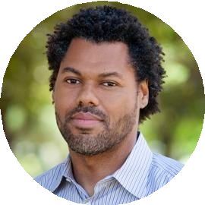
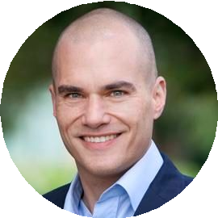
Optimizing Self-Awareness
1 Week Experience
High-performing leaders demonstrate a thorough understanding of who they are and how they “show up” when driving toward organizational goals. They recognize the value of this critical interpersonal competency and leverage situationally appropriate verbal and non-verbal signals to engage and motivate those they lead.
Estimated Time Commitment: 2.5-3 hours
Faculty Video Lectures: 30 Minutes Create Action Plan: 75-90 Minutes Interactive Activities: 45-60 Minutes
Participants learn the Stanford Leadership Framework and gain an understanding of the psychological and behavioral dimensions of the “self.” They then develop insights into how their behavior is perceived by others and learn how to modulate how they “show up” to inspire and inﬂuence those critical to reaching their goals.
Key Learnings
Internal vs. External Self-Awareness
Identifying Your Motivation
The Motivations of Others
Behavioral Adaptability
Understanding Non-Verbal Cues
Team Dynamics
Assignment Details: Create an Action Plan
Identify a critical interaction or relationship where interpersonal dynamics will be critical to meeting your goals.
Analyze the behaviors and motivations of those involved.
Faculty: Brian Lowery & Christian Wheeler
Brian Lowery is a Professor of Organizational Behavior and a social psychologist by training. His research focuses on the way relationships among groups and people shape the way we understand ourselves and interact with others. He has a particular interest in inequality and fairness.
BRIAN LOWERY
S. Christian Wheeler is the StrataCom Professor of
Management and Professor of Marketing at Stanford GSB. In his research on consumer behavior, he explores the formation, change, and expression of evaluations. At Stanford, Professor Wheeler teaches courses on
S. CHRISTIAN WHEELER
Management Agility and Research Methodology.
● Plan to modulate your behavior to increase followership.
46
Copyright © 2020 ExecOnline, Inc. All Rights Reserved.

Slide 47
Communicating Persuasively & Building Trust
STANFORD GRADUATE SCHOOL OF BUSINESS
47

Slide 48
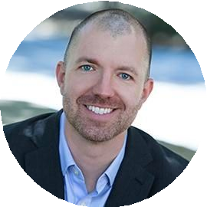
Communicating Persuasively & Building Trust
1 Week Experience
In order to lead, you have to convince others to follow. Whether you’re kicking off a new project with your team or appealing to senior stakeholders for the go-ahead on your next big idea, communicating your ideas persuasively is critical to generating the excitement, engagement and trust you need.
Estimated Time Commitment: 2.5-3 hours
Faculty Video Lectures: 30 Minutes Create Action Plan: 75-90 Minutes Interactive Activities: 45-60 Minutes
This 1-week experience featuring Professor Zakary Tormala introduces participants to a series of persuasive tactics grounded in extensive research into human psychology and decision-making. Participants learn how to apply these tactics to a variety of communication situations to gain credibility and earn trust, and heighten enthusiasm of those whose support is needed for success.
Key Learnings
Make it Important
Engagement Triggers
Establish Similarity
Take an Unexpected Position
Credibility Heuristics
Faculty: Zakary Tormala
Zakary Tormala is the Laurence W. Lane Professor of Behavioral Science and Marketing at Stanford GSB. His research focuses on the areas of attitudes, persuasion, and social inﬂuence. He specializes in conducting lab and ﬁeld experiments designed to enhance our
Assignment Details: Create an Action Plan
Identify a communication opportunity critical to achieving a strategic goal.
Analyze key aspects of the intended audience.
Structure and plan to deliver that communication incorporating appropriate persuasion tactics.
ZAKARY TORMALA
understanding of attitude, belief, and behavior change. He publishes extensively on these topics and has served on the editorial boards of the leading scientiﬁc journals in his ﬁeld.
48
Copyright © 2020 ExecOnline, Inc. All Rights Reserved.

Slide 49
Leveraging Different Perspectives
STANFORD GRADUATE SCHOOL OF BUSINESS
49

Slide 50
Leveraging Different Perspectives
1 Week Experience
Conﬂict is inevitable in business, and being able to recognize and address it is a hallmark of strong leadership. In instances of conﬂict, high-performing leaders understand the necessity of considering others’ perspectives, and those who spend time doing so are more effective at generating desired business outcomes.
Estimated Time Commitment: 2.5 - 3 hours
Faculty Video Lectures: 30 Minutes Create Action Plan: 75 - 90 Minutes Interactive Activities: 45-60 Minutes
In this experience, participants will understand how to “get out of one’s own head” and adopt the perspective of others. This enables participants to defuse conﬂict, generate productive ideas, and move toward solutions that embrace the needs and motivations of all involved.
Key Learnings
Perspective-Taking Explained
Understanding Conﬂict
How Your Team Can Have a Good Fight
Managing Conﬂict
Assignment Details: Create an Action Plan
Identify an existing or anticipated conﬂict related to Leadership Focus
Incorporate tactics to better understand the differing perspectives of those involved.
Choose one conﬂict situation and attempt to make headway by gaining a better understanding of those involved
Faculty: Brian Lowery
Brian Lowery is a Professor of Organizational Behavior and a social psychologist by training. His research focuses on the way relationships among groups and people shape the way we
BRIAN LOWERY
understand ourselves and interact with others. He has a particular interest in inequality and fairness.
50
Copyright © 2020 ExecOnline, Inc. All Rights Reserved.

Slide 51
Adapting to Changing Contexts
STANFORD GRADUATE SCHOOL OF BUSINESS
51

Slide 52
Adapting to Changing Contexts
1 Week Experience
Everyone’s experience is shaped by context, and leaders who demonstrate effective contextual awareness are better able to adapt and control their behavior in various situations. Recognizing the need and working to adjust context drives organizational productivity and contributes to a more positive team environment.
Estimated Time Commitment: 2.5 - 3 hours
Faculty Video Lectures: 30 Minutes Create Action Plan: 75 - 90 Minutes Interactive Activities: 45-60 Minutes
In this experience, Professors Lowery and Wheeler illustrate how the context in which we operate has a tremendous effect on our behavior and those of our team members. Participants will explore the different aspects of context – such as physical environment and differences in status – and how they can be modulated to better achieve leadership goals.
Key Learnings
Elements of Context
Team Attributes and Motivation
The Importance of Status Flexibility
Understanding Status Cues
Changing Context
Assignment Details: Create an Action Plan
Analyze their own business context, including environment and interpersonal dimensions
Identify opportunities to change contextual elements to better achieve their goals
Plan to implement a contextual change
Faculty: Brian Lowery & Christian Wheeler
Brian Lowery is a Professor of Organizational Behavior and a social psychologist by training. His research focuses on the way relationships among groups and people shape the way we understand ourselves and interact with others. He has a particular interest in inequality and fairness.
BRIAN LOWERY
S. Christian Wheeler is the StrataCom Professor of
Management and Professor of Marketing at Stanford GSB. In his research on consumer behavior, he explores the formation, change, and expression of evaluations. At Stanford, Professor Wheeler teaches courses on
S. CHRISTIAN WHEELER
Management Agility and Research Methodology.
52
Copyright © 2020 ExecOnline, Inc. All Rights Reserved.

Slide 53
Communicating With Impact
ExecOnline experience featuring Lindy Amos
53

Slide 54



Communicating with Impact
1 Week Experience
Effective managers are constant communicators. However, it’s all too easy for managers to try to rush to get across a message or to miss an opportunity to go beyond delivering information to encouraging action.
Estimated Time Commitment: 2.5-3 hours
Faculty Video Lectures: 30 Minutes Create Action Plan: 75-90 Minutes Interactive Activities: 45-60 Minutes
This one-week experience enables managers to build engagement and drive results through adopting a set of simple and practical frameworks that lead to effective communication.
Key Learnings
Work from an Audience-Centered Mindset
Craft Messages that Move
Leverage Questions to Build Credibility
Remain Authentic In Your Communication Performance
Leverage Storytelling
Address Both Daily Impact and Key Performances
Featured Expert: Lindy Amos
Lindy Amos is a highly sought-after Executive Communications consultant. For more than ﬁfteen years she has collaborated with senior-level individuals and teams internationally,
LINDY AMOS
developing their communications and leadership abilities.
Assignment Details: Create an Action Plan
Start from Common Ground
Simplify Your Message
Tell a Story
Leverage Questions
Copyright © 2020 ExecOnline, Inc. All Rights Reserved.
54

Slide 55
Managing Uncertainty
ExecOnline experience featuring Dorie Clark
55

Slide 56

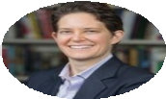
Managing Uncertainty
1 Week Experience
Business environments are becoming increasingly volatile and complex, but the uncertainty is sometimes compounded by events over which the manager has no control. Navigating such situations requires agility, skill, and proactivity.
Estimated Time Commitment: 2.5-3 hours
Faculty Video Lectures: 30 Minutes Create Action Plan: 75-90 Minutes Interactive Activities: 45-60 Minutes
This 1-week experience featuring Dorie Clark provides insights and tactics for dealing with situations of great uncertainty. Much of it involves obtaining the right information and ensuring that key communication channels are set up, but it also requires working with team members in ways that address their doubts and fears. Leading teams through times of great uncertainty is a critical management competency.
Key Learnings
Assessing Your Environment
Monitoring the Signals
Remaining Agile and Questioning Your Assumptions
How to Lead When You Don’t Know the Answers
Building Team Cohesion During Challenging Times
Goal Setting and Negotiating Goals
Featured Leadership Expert: Dorie Clark
Dorie Clark is a noted thought leader and trusted business advisor, having developed managers and working environments for dozens of companies including Google, Deloitte, FedEx, Sony, World Bank, and the Bill & Melinda Gates Foundation. She is a
DORIE CLARK
frequent contributor to the Harvard Business Review, a New York Times bestselling author, and was named one of the top 50 business thinkers in the world by Thinkers50.
Assignment Details: Create an Action Plan
Describe your disruptor, list knowns and unknowns, and map out future scenarios
Review existing information channels and deﬁne a new one
Outline tactic(s) for steadying your team
Copyright © 2020 ExecOnline, Inc. All Rights Reserved.
56

Slide 57
Managing Virtually
ExecOnline experience featuring Dorie Clark
57

Slide 58
Managing Virtually
1 Week Experience
Teams are rapidly adopting new, virtual working environments that present unique management dynamics. Managers of remote employees may ﬁnd their teams are prone to feeling disengaged and subject to priority confusion. They may experience a misalignment of work, feel isolated, or experience burnout.
Estimated Time Commitment: 2.5-3 hours
Faculty Video Lectures: 30 Minutes Create Action Plan: 75-90 Minutes Interactive Activities: 45-60 Minutes
This 1-week experience featuring Dorie Clark introduces valuable insights and practical tools to develop the leader’s organizations need to lead productive virtual teams. Managers will be equipped to build connections across the organization, communicate effectively with their team, and foster positive working relationships that will enable them to thrive in a virtual environment.
Key Learnings
Being an Emotionally Intelligent Leader from Remote
Getting Mindshare from Senior Leaders
How to Communicate Consistently with Your Team
Helping Your Team Cope with the Pressures of Responsiveness
Handling Difﬁcult Conversations When You Can’t Talk in Person
Helping Your Team Build Strong Relationships with One Another
Featured Leadership Expert: Dorie Clark
Dorie Clark is a noted thought leader and trusted business advisor, having developed managers and working environments for dozens of companies including Google, Deloitte, FedEx, Sony, World Bank, and the Bill & Melinda Gates Foundation. She is a
DORIE CLARK
frequent contributor to the Harvard Business Review, a New York Times bestselling author, and was named one of the top 50 business thinkers in the world by Thinkers50.
Assignment Details: Create an Action Plan
Connect with a Senior Leader
Introduce a New Communication Practice
Build a Relationship within Your Team
58
Copyright © 2020 ExecOnline, Inc. All Rights Reserved.

Slide 59
Accelerating Women Leaders Series
(Coming February 2021)
UC Berkeley Center for Executive Education

Slide 60





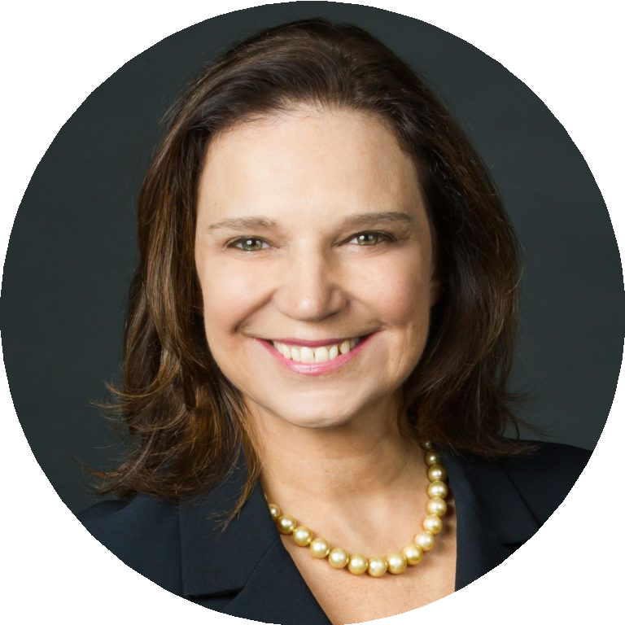
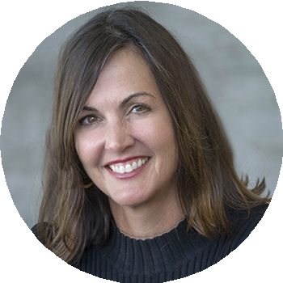
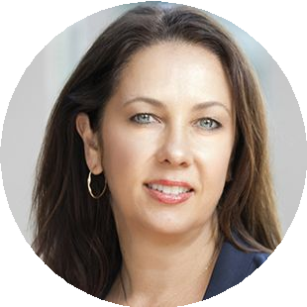
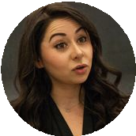
Accelerating Women Leaders: A New Series in AEP
UC Berkeley and ExecOnline are partnering to create a series of high-impact experiences that will empower women to focus on three key leadership areas:
COMING IN FEBRUARY 2021
In celebration of the 150th anniversary of UC Berkeley’s admittance of women
Charting Your Path
Self Leadership
Accelerating Your Team
Team Performance
Elevating Your Organization
Organizational Leadership
FEATURED FACULTY
ANN E. HARRISON
KELLIE A. MCELHANEY
LAURA KRAY
SAHAR YOUSEF
60

Slide 61


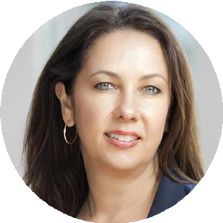
Embracing a Growth Mindset
ACCELERATING WOMEN LEADERS SERIES
1 Week Experience
The future of business requires a growth mindset, which involves putting yourself out there, sometimes failing publicly, and taking on stretch opportunities that may involve risk but allow you to learn and grow as a leader. Because there is often bias associated with vulnerability in the workplace, this can be a struggle for everyone; no one wants to appear as though they don’t have the answer.
Estimated Time Commitment: 2.5 - 3 hours
Faculty Video Lectures: 30 Minutes Create Action Plan: 75 - 90 Minutes Interactive Activities: 45-60 Minutes
This experience highlights women’s perspectives on situations that require courage and conviction. Participants will leverage a speciﬁc, actionable approach to fostering a growth mindset and gain the tools they need to reframe unproductive internal narratives. When connected to a sense of purpose, and through building supportive work relationships, they can view challenges and roadblocks as opportunities and take intelligent risks to advance their careers.
Key Learnings
Growth vs. Fixed Mindset
Stereotypes and Why Gender Identity Makes a Difference
Imposter Syndrome
Ambivalence about Power and Leadership
Sense of Purpose and Aspiration
The Importance of Relationships to Leadership
Faculty: Dr. Laura Kray
Laura Kray is a leading expert on the
social-psychological barriers inﬂuencing women’s career attainment. Dr. Kray is the Ned and Carol Spieker Chair in Leadership and Faculty Director of the Center for Equity, Gender, and Leadership at UC Berkeley’s Haas School of Business. She also founded the Women’s Executive Leadership Program at Berkeley Executive Education in 2008
Assignment Details: Create an Action Plan
Shift your mindset to reinterpret past setbacks and your sense of purpose.
Reframe upcoming opportunities with a growth lens.
Create a concrete roadmap to realize those opportunities.
identify
and remains the faculty director today.
Copyright © 2021 ExecOnline, Inc. All Rights Reserved.

Slide 62
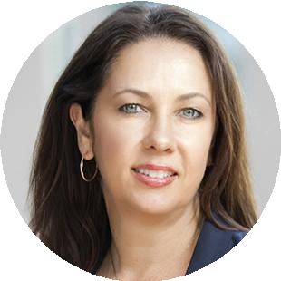
Cultivating Collaborative Leadership
ACCELERATING WOMEN LEADERS SERIES
1 Week Experience
Women’s leadership is needed more than ever in today’s business environment. As women have successfully risen in organizations, they have identiﬁed the need to drive a more collaborative approach to decision-making. They understand they can create a competitive advantage for their organizations by encouraging leadership cultures that foster collective intelligence and a willingness to challenge the status quo.
Estimated Time Commitment: 2.5 - 3 hours
Faculty Video Lectures: 30 Minutes Create Action Plan: 75 - 90 Minutes Interactive Activities: 45-60 Minutes
Participants will learn to distinguish between “execution teams” focused on implementation and efﬁciency, and “learning teams” deﬁned by their ability to problem-solve and innovate. The latter requires collaborative interactions and decision-making. To enable this, women leaders will gain the skills needed to identify leverage points in their organizations where collaboration is critical, advocate for others, and create win-win situations for different stakeholders.
Key Learnings
The Collaborative Approach to Leadership
Understanding The Women’s Perspective in Business
Questioning the Status Quo
Advocating for Others
Leading Learning Teams vs. Execution Teams
Moving from the Bystander to the Confronter Mindset
Faculty: Dr. Laura Kray
Laura Kray is a leading expert on the
social-psychological barriers inﬂuencing women’s career attainment. Dr. Kray is the Ned and Carol Spieker Chair in Leadership and Faculty Director of the Center for Equity, Gender, and Leadership at UC Berkeley’s Haas School of Business. She also founded the Women’s Executive Leadership Program at Berkeley Executive Education in 2008 and remains the faculty director today.
Assignment Details: Create an Action Plan
Identify a situation in which top-down approaches are hampering performance.
Formulate a collaborative, democratic approach to addressing the situation that will better leverage collective intelligence.
Prepare to implement changes or new processes by creating a succinct Action Plan.
Copyright © 2021 ExecOnline, Inc. All Rights Reserved.

Slide 63

Developing Equity Fluent Teams
ACCELERATING WOMEN LEADERS SERIES
1 Week Experience
Greater inclusion results in improved decision-making, enhanced team creativity, and overall better performance and business outcomes. Equity Fluent Leaders understand the value of different lived experiences and courageously use their power to address barriers, increase access, and drive change for positive impact.
Estimated Time Commitment: 2.5 - 3 hours
Faculty Video Lectures: 30 Minutes Create Action Plan: 75 - 90 Minutes Interactive Activities: 45-60 Minutes
In this experience, women leaders will learn effective inclusion strategies in team dynamics, including how to foster psychological safety, model empathy and vulnerability, overcome common barriers, and amplify non-majority groups’ voices. Mastering inclusive leadership is not only an opportunity to improve team performance; it is also critical to elevating and sponsoring other women in your organization.
Key Learnings
Inclusive Leadership and its Value
Barriers and Blindspots for Inclusive Leaders
The Value of Creating Psychological Safety
Keys to Psychologically Safe Teams: Empathy, Vulnerability, & Feedback
Methods for Measuring Psychological Safety
Faculty: Dr. Kellie McElhaney
Kellie McElhaney is on the Berkeley Haas faculty as a Distinguished Teaching Fellow and the Founding Director of the Center for Equity, Gender and Leadership, which seeks to educate equity ﬂuent leaders to ignite and accelerate change. She is a leading expert on equity ﬂuent leadership, value-creating strategies of diversity and inclusion, and corporate social responsibility. Dr. McElhaney consults and keynotes for Global 1000 companies and organizations all over the world and received the Founder and Visionary Award at Haas in 2013.
Assignment Details: Create an Action Plan
Initiate an informal conversation with one person in your team, and discuss an inclusion-related issue.
Identify and describe speciﬁc inclusion-related challenges and opportunities.
Create a concrete plan to implement inclusion strategies and heighten
psychological safety.
63
Copyright © 2021 ExecOnline, Inc. All Rights Reserved.

Slide 64
Business Finance Fundamentals
(Coming 1H 2021)
Wharton

Slide 65


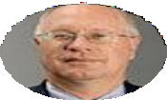
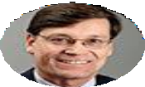
Responding Rapidly to Client Demand for Financial Acumen
Financial Acumen has been one of the top requests from our clients, and we are excited to announce a 3-Week Experience on Business Finance Fundamentals in partnership with Wharton.
COMING IN 1H 2021
Wharton is known the world over as
“The Finance School”
For over 120 years, Wharton’s Finance Department has remained at the forefront of ﬁnance education and research.
FEATURING RENOWNED FACULTY
RICHARD LAMBERT
Miller-Sherrerd Professor; Professor of Accounting The Wharton School
CHRISTOPHER D. ITTNER
EY Professor of Accounting; Chairperson, Accounting Department
The Wharton School
65

Slide 66
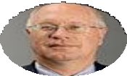
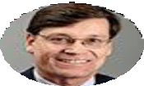
Business Finance Fundamentals
Build Financial Acumen to Enhance Your Strategic Focus
Leaders require ﬁnancial acumen to be successful as they take on greater responsibilities - creating business cases for new initiatives, modeling resourcing needs, and managing budgets. To do so, they need to know how ﬁnancial information is collected, aggregated, and published to understand the “big picture” for their companies, and to target their own efforts to align with their organizations’ ﬁnancial strategies.
Participants will learn the fundamentals of ﬁnancial reporting: balance sheets, income statements, and cash ﬂow statements. In so doing, they will discover how to draw conclusions from those documents, increasing their ability to make sound ﬁnancial and strategic decisions for their organizations.
RICHARD LAMBERT
Miller-Sherrerd Professor; Professor of Accounting The Wharton School
CHRISTOPHER D. ITTNER
EY Professor of Accounting; Chairperson, Accounting Department The Wharton School
Richard Lambert teaches a wide range of courses in the areas of ﬁnancial reporting, cost and management accounting, and compensation and performance measurement. Professor Lambert is a recipient of the Helen Kardon Moss Anvil Award for Teaching Excellence at Wharton.
Christopher Ittner teaches the Management Accounting MBA course and executive education sessions on cost accounting and marketing metrics. In addition, he runs management accounting doctoral courses for students from across the US and Europe. He is the recipient of several MBA teaching awards.
He is a member of the Editorial Board of the Journal of Accounting Research and The Review of Accounting Studies. He received a Ph.D from Stanford in 1982, and his latest book is entitled Financial Literacy for Managers: Finance and Accounting for Better Decision-Making, Second Edition.
Professor Ittner’s work on the association between customer satisfaction measures and ﬁnancial performance received the American Accounting Association’s Notable Contribution to Management Accounting Literature Award. He received his Ph.D in Business Administration from Harvard.
66

Slide 67
Leader as Coach
(Coming 1H 2021)
DUKE CORPORATE EDUCATION

Slide 68

Bringing out the Best in Others
Becoming a “Leader as Coach”
To increase productivity and creativity and adapt to the shifting needs of today’s business environment, organizations need their leaders to take a more active role in coaching their people and teams. Leaders must develop a coaching mindset that seeks to discover and unlock their employees’ potential.
Through this series of experiences, participants will learn to incorporate coaching as a key leadership lever to improve performance, identify and nurture strengths, and coach people through change.
Leaders will learn how to:
Teach not tell, how to leverage powerful questions in coachable moments to provoke learning and change
Build the trust needed to be a good coach as a result of supportive, inquisitive leadership
Learn and apply proven techniques used by experts in other ﬁelds including science, sports, and entertainment from renowned experts
Become equipped with toolkit and skills needed to seize upon coachable moments that elevate performance and accelerate development
SANYIN SIANG
Founder & Executive Director, Fuqua Coach K Center on Leadership & Ethics
Sanyin’s experience in strategic planning, partnerships, and coaching has helped organizations and c-suite executives identify gaps and lead more effectively in a rapidly changing marketplace and talent space. She works with and coaches top generals, Olympians, Entertainment executives, Fortune 500 CEOs, and tech startup founders.
Sanyin is the Thinkers50 award winner for Coaching & Mentoring, and she is a 2017 & 2018 LinkedIn 2017 Top 20 Global Inﬂuencer with more than 1 million followers. Her thought leadership has appeared in Forbes, New York Times, Fortune, WSJ, and CNN.
68

