Slide 1



Slide 2



A culture of Continuous learning
Take ownership of your professional and personal development:
Define your short and/or long-term Career Goals
Assess your current knowledge, skills and behaviors
Prepare a plan to develop those areas you want to work on
Ask for projects/assignments/duties that stretch you
Look for a mentor that can support your development needs
Look for specific training that focusses on your developmental needs
Valuing
others
Impacting
patients
Developing
ourselves
Achieving
goals

Slide 3



Develop yourself with two different platforms
On-demand training focused on micro and in-depth learning
Development Programs from the world’s top business schools

Slide 4
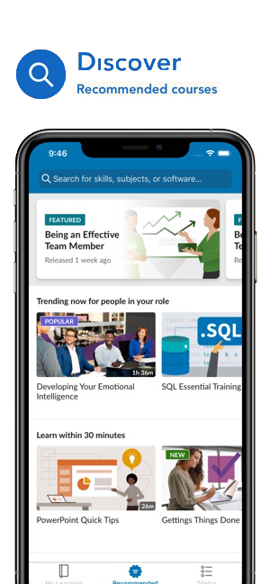
Leadership
Business Strategy
Coaching & Mentoring
Innovation
Decision-making
Teams & Collaboration
Operations Management
Professional Development
Communication & Public Speaking
Collaboration
Writing
Excel / Word / PowerPoint / Outlook
Office 365 / Windows
On-demand training focused on micro and in-depth learning
Functional
Sales
Project Management & Six Sigma
Marketing
Finance & Accounting
Customer Services
L&D Education/ HR & Recruiting
Business Intelligence / Analyst
15,000+ courses in 7 languages
Access through Bioventus Okta

Slide 5









Development Programs from the world’s top business schools
3-4 hours per training week
Get Executive Certificates upon completion
Enrollment at https://platform.execonline.com/p3/register/42eaa809-4f76-4e74-ab49-eb3689cd22d7

Slide 6


www.linkedin.com/learning

Slide 7

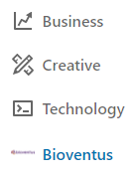

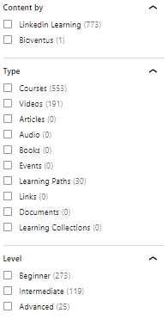
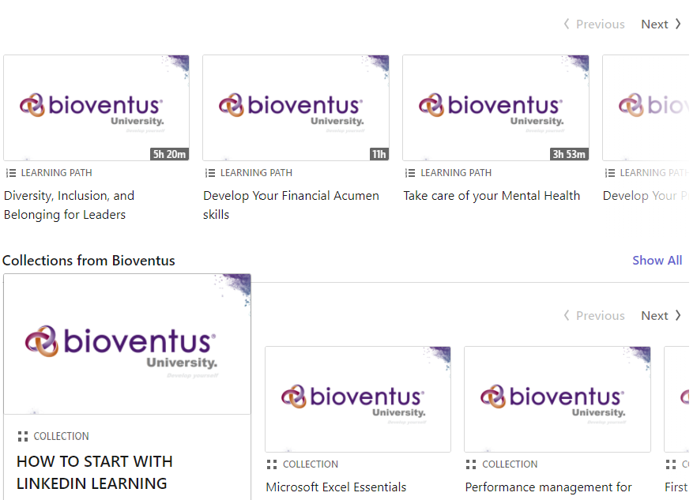
ALL content Is available.
www.linkedin.com/learning

Slide 8
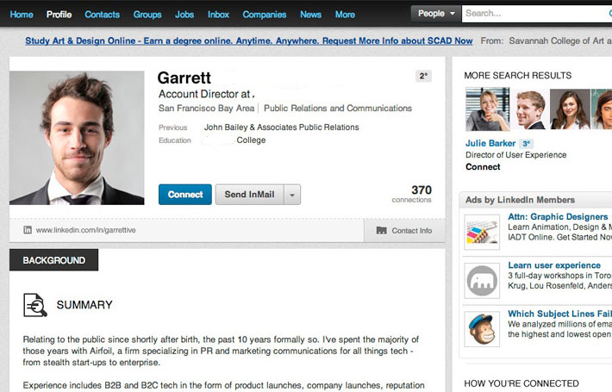
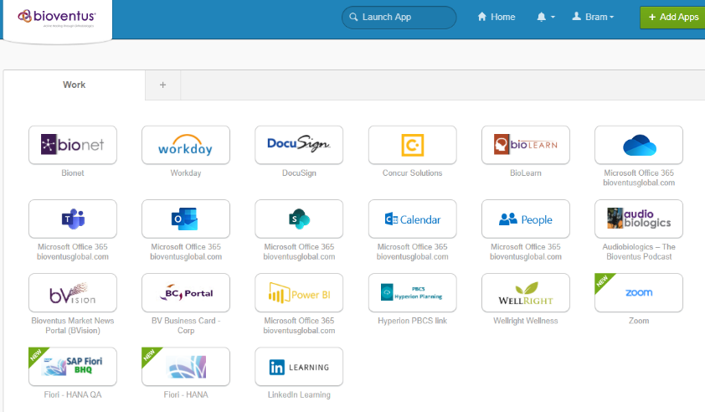
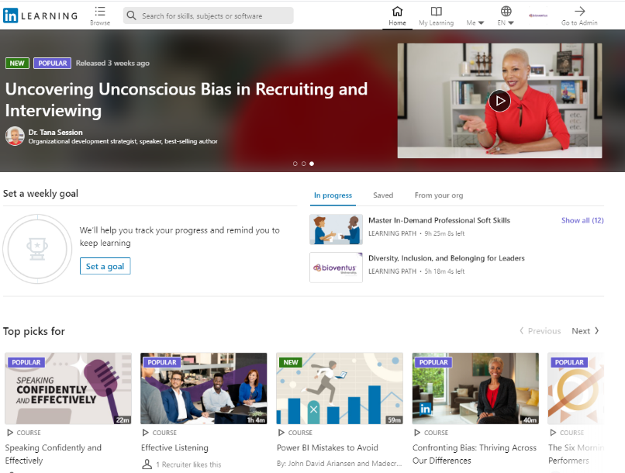
How does it work?
To be able to have access to LinkedIn learning you have to
have your own (private) LinkedIn account. You can create
one through www.linkedin.com
Go to www.Bioventus.okta.com and click on the LinkedIn
learning app.
Once you are in you will be asked to select your personal
areas of interest. After this you can immediately start exploring.
We recommend everyone to start with a quick training on
how to start using LinkedIn Learning. You can find this under
the Bioventus section.

Slide 9
https://platform.execonline.com/p3/register/42eaa809-4f76-4e74-ab49-eb3689cd22d7

Slide 10
ExecOnline Programs
One-week Learning Experiences:
Three-week Academic Programs:
 | 1-Week Experiences | 3-Week Programs
Total Time Commitment | 3-4 hours | 10-12 hours
On-Demand Video | 30-45 minutes | 5 hours
Live Virtual Events | None | One 60-minute event
Availability | A new Class starts Every Monday | Offered 5x per year Class 2: April 26th Class 3: July 12th Class 4: September 6th Class 5: October 25th

Slide 11











Available programs
BUSINESS TRANSFORMATION | PRACTICING LEADERSHIP | WOMEN IN LEADERSHIP | COMING IN H1 2021
Implementing Winning Strategies 3 WEEK EXPERIENCE | LEARN MORE | Fostering Inclusion & Diversity 3 WEEK EXPERIENCE | LEARN MORE | Embracing a Growth Mindset 1 WEEK EXPERIENCE | LEARN MORE Cultivating Collaborative Leadership 1 WEEK EXPERIENCE |LEARN MORE Developing Equity Fluent Teams 1 WEEK EXPERIENCE | LEARN MORE | Leveraging Different Perspectives 1 WEEK EXPERIENCE Adapting to Changing Contexts 1 WEEK EXPERIENCE
Accelerating Change Readiness & Agility 3 WEEK EXPERIENCE | LEARN MORE | Communicating Persuasively & Building Trust 1 WEEK EXPERIENCE | LEARN MORE Optimizing Self-Awareness 1 WEEK EXPERIENCE | LEARN MORE
Selling Through Customer Centricity 3 WEEK EXPERIENCE | LEARN MORE |  |  | Maximizing Operational Effectiveness 3 WEEK EXPERIENCE
Driving Digital Transformation 3 WEEK EXPERIENCE | LEARN MORE | Strengthening Workplace Wellness 3 WEEK EXPERIENCE | LEARN MORE Achieving Mental Flow & Thriving 1 WEEK EXPERIENCE | LEARN MORE Building Resilience & Preventing Burnout 1 WEEK EXPERIENCE | LEARN MORE Enhancing Team Wellbeing 1 WEEK EXPERIENCE | LEARN MORE |  | Leader as Coach THREE 1 WEEK EXPERIENCES
Communicating With Impact 1 WEEK EXPERIENCE | LEARN MORE Managing Uncertainty 1 WEEK EXPERIENCE | LEARN MORE Managing Virtually 1 WEEK EXPERIENCE | LEARN MORE |  |  | Business Finance Fundamentals 3 WEEK EXPERIENCE

Slide 12
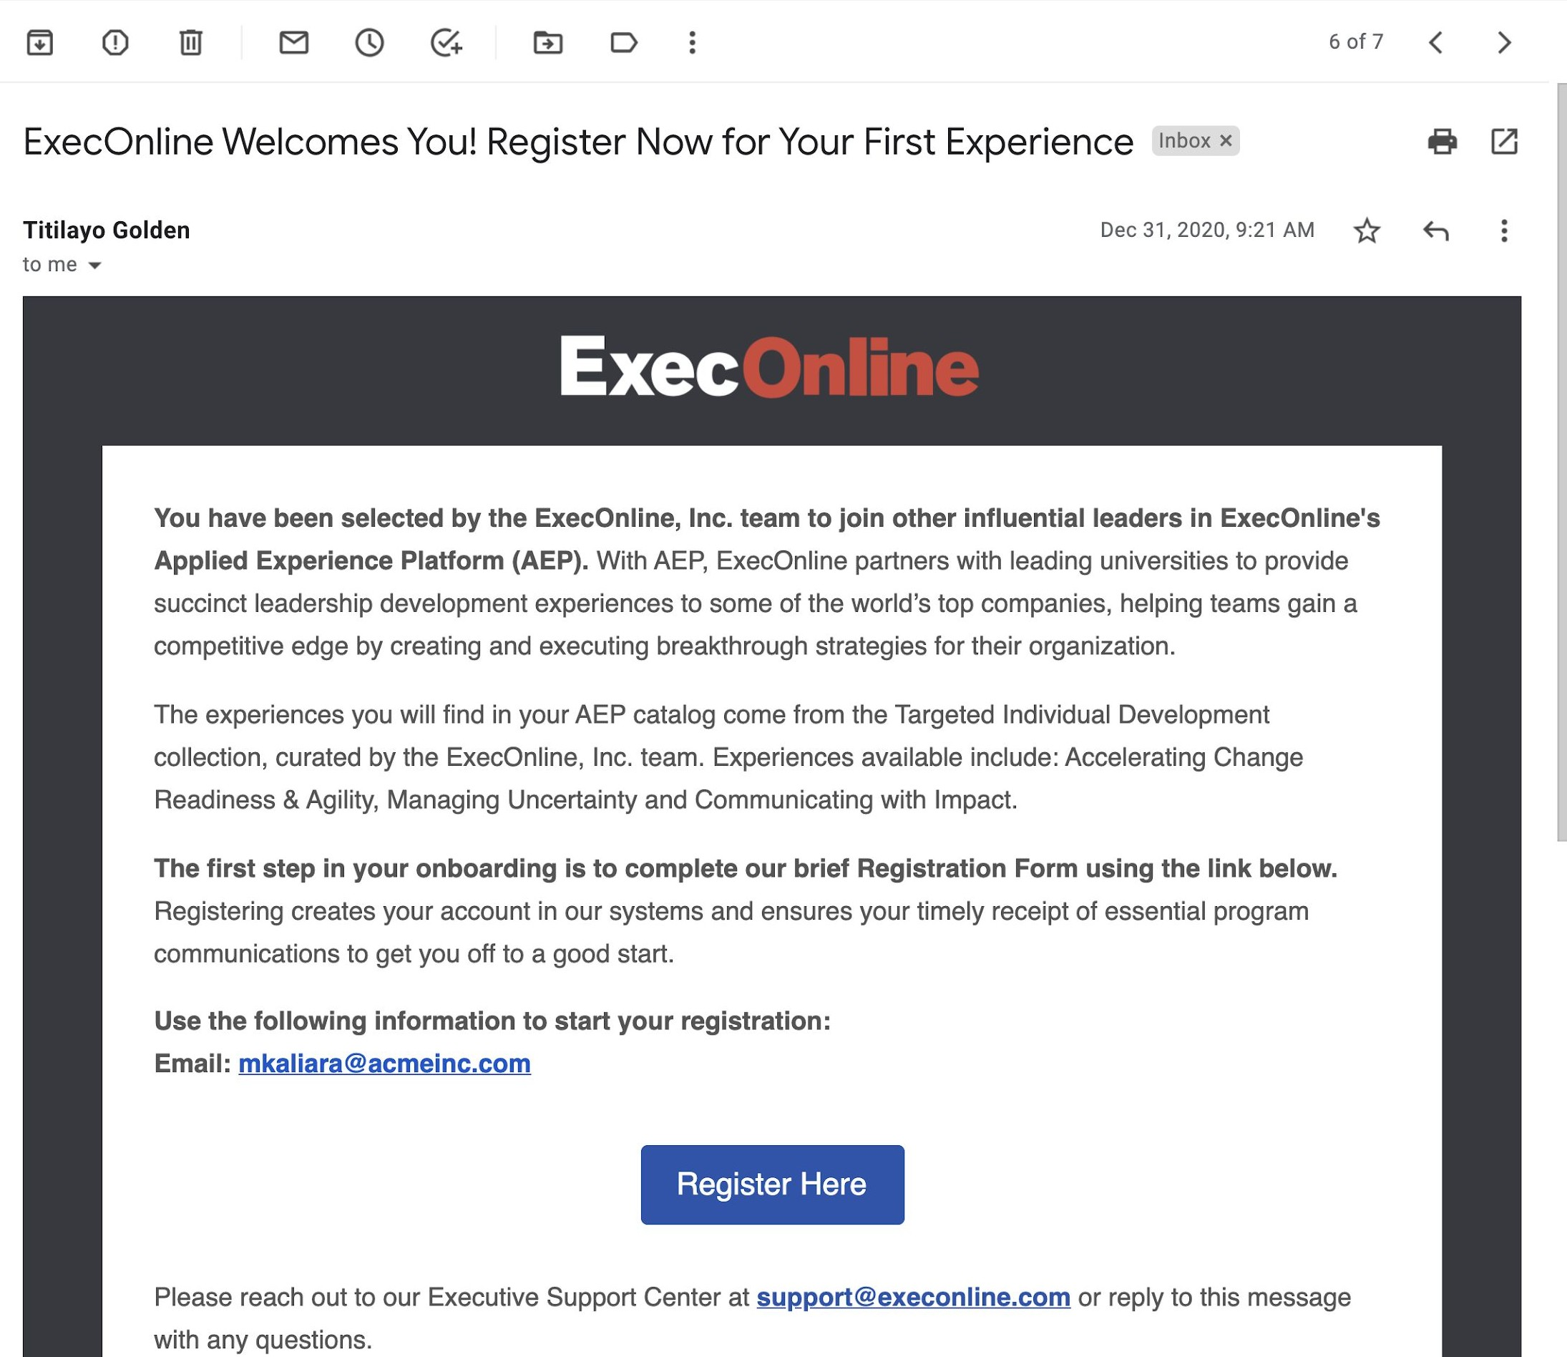
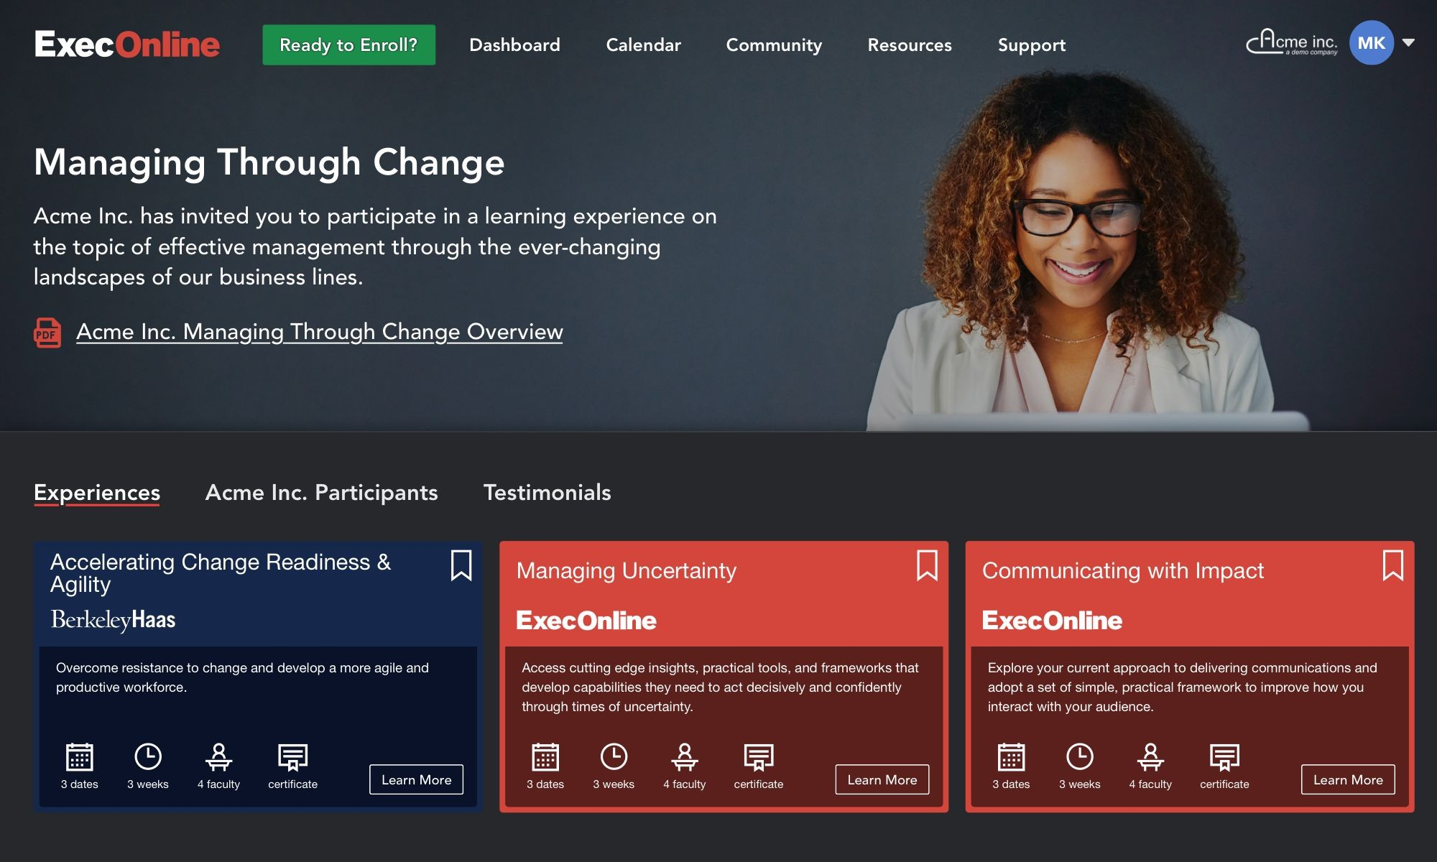
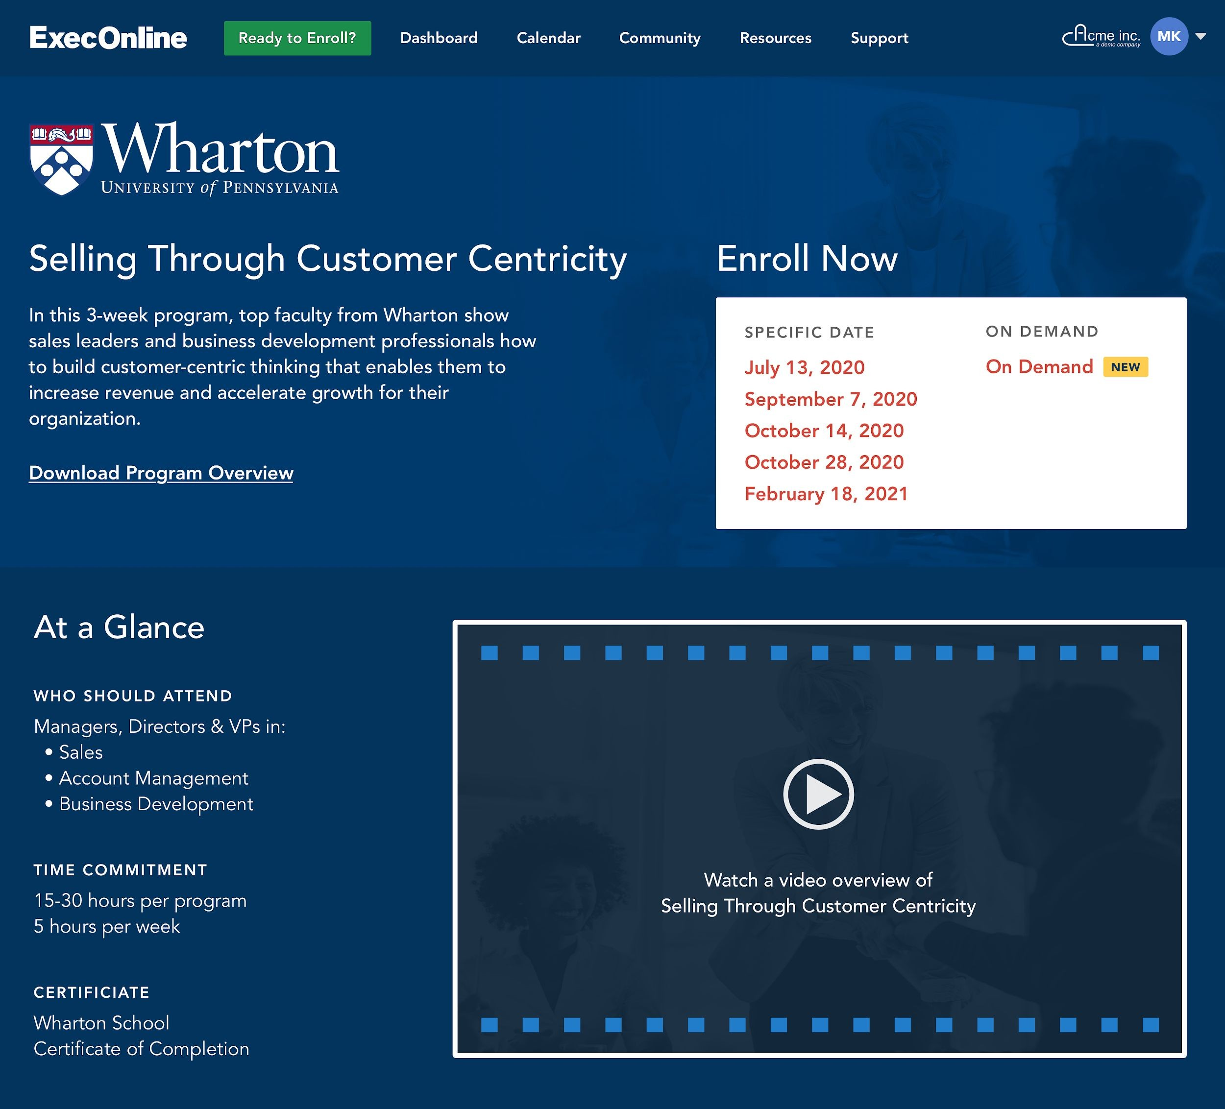
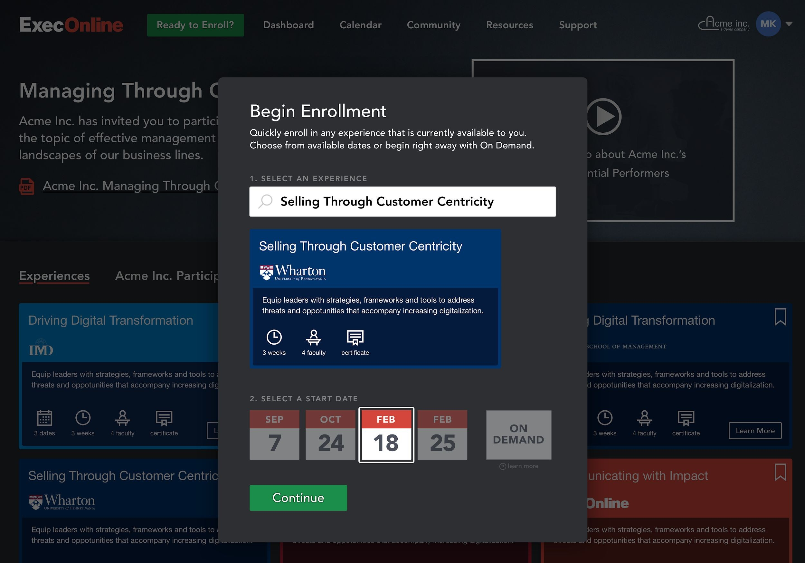
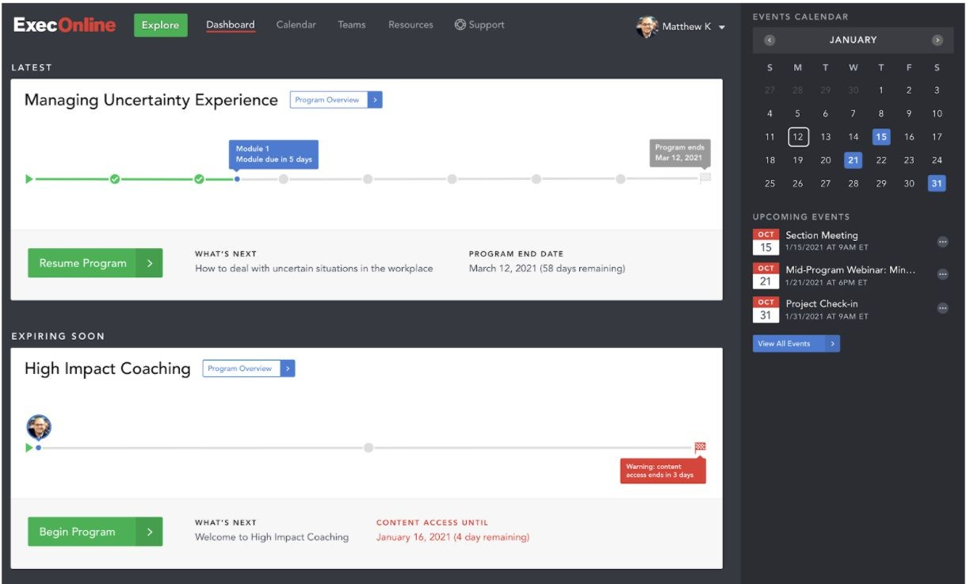
How does it work?
Visit https://platform.execonline.com/p3/register/42eaa809-4f76-4e74-ab49-eb3689cd22d7 and explore all the different
Training Programs Bioventus University has to offer and register using
your Bioventus Email Address
Once Registered, you can search for any training of interest and learn
more about the training itself
To ensure you are choosing the right training for your goals watch
previews and choose from course offerings
Choose the date you want to start your program
You will participate and complete your training on the same platform

Slide 13
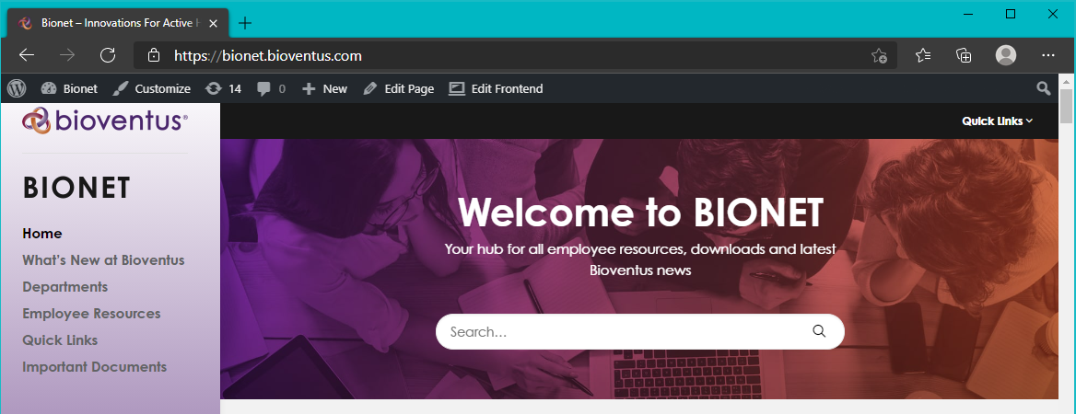
Where to find this information

Slide 14

30 Hour Challenge
Can you commit to 30 hours of
training in 2021?
Get one day of paid time off
+
Invitation to
THE Executive Network Event

Slide 15

Thank you.

