Slide 1
Bioventus Recruitment Guide

Slide 2
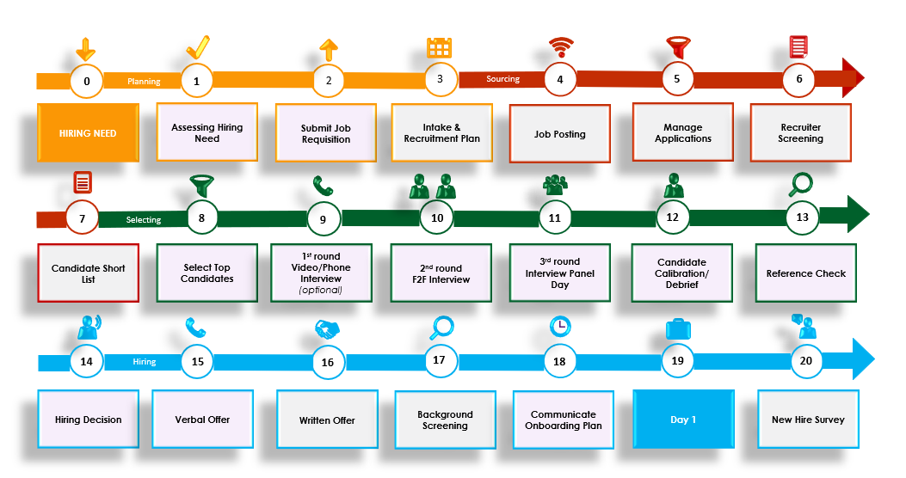
Process Flow

Slide 3
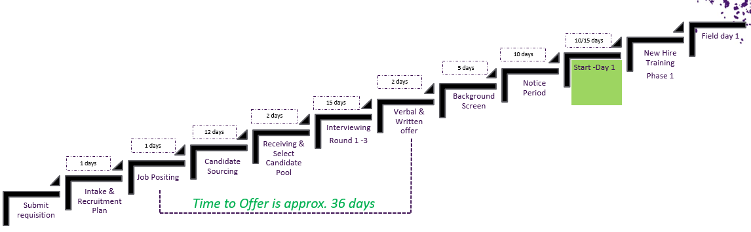
Recruitment Key Milestones & Timelines
The key to developing an efficient Recruitment Plan is best done by calculating backwards from the time you need/want the new hire to start. Using the average (business) days per recruitment step, you can determine and schedule your important milestones.

Slide 4





Recruitment Focus
Planning
Assess carefully what your hiring need is and submit your hiring request to your level-up manager in a timely manner and include your hiring need data for a smooth approval process
Plan all your Recruitment Activities in advance (Interview dates & locations, Interview Panel)
Sourcing
Communicate timely and frequently with Talent Acquisition about the progress of the Recruitment Plan
Use your teams’ networks to attract talent. Promote the Talent Referral Program
Assess the candidate short-list quickly and provide feedback and insights back to Talent Acquisition
Select and invite only the top candidates for your interview process
Prepare well for each interview. Print the Interview Scripts and Assessment Forms in advance
Be on time for all your interviews
Conduct all (2-3) Interview Rounds and use Candidate Assessment Form for each candidate and each interview. Ensure you take notes using the STAR Methodology
Debrief with Talent Acquisition after each interview round and align on next steps
Complete the calibration for all final candidates through the assessment forms
Select recommended candidate for hire and request a Verbal Offer Approval via Talent Acquisition
Build a Talent Bench by determining if other candidates are gold-, silver or bronze medalists
Selecting
After formal approval, provide the verbal offer to the preferred candidate. Upon verbal acceptance, inform Talent Acquisition to initiate Workday processing
Reject personally all final candidates and provide them with insightful feedback
Complete all Workday pre-onboarding tasks timely
Prepare and share the new hire onboarding plan before official start date
Stay in close contact with the new hire during pre-hire time
Hiring

Slide 5
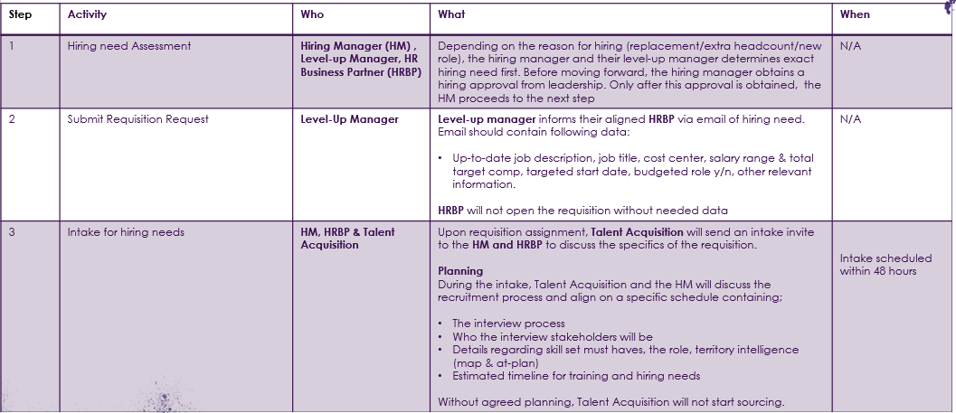
Phase 1: Planning

Slide 6
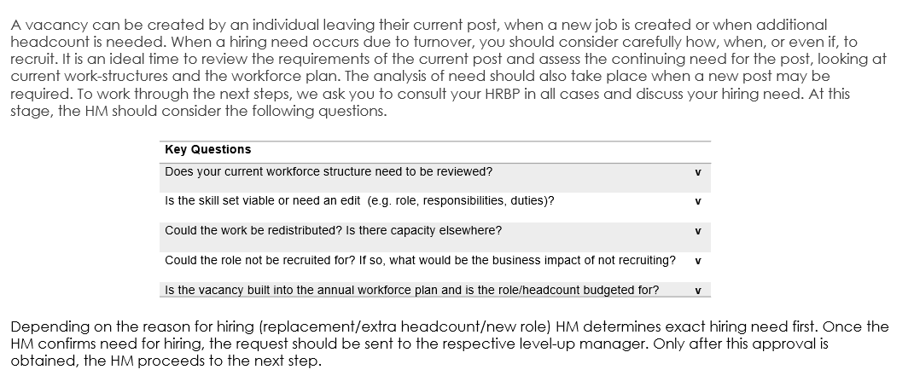
Hiring Need Assessment

Slide 7
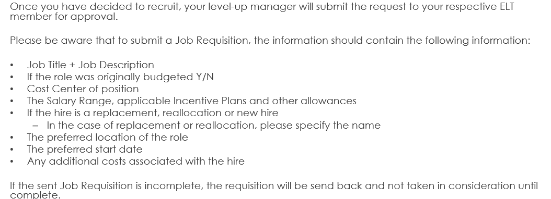
Submitting a Job Requisition Request

Slide 8
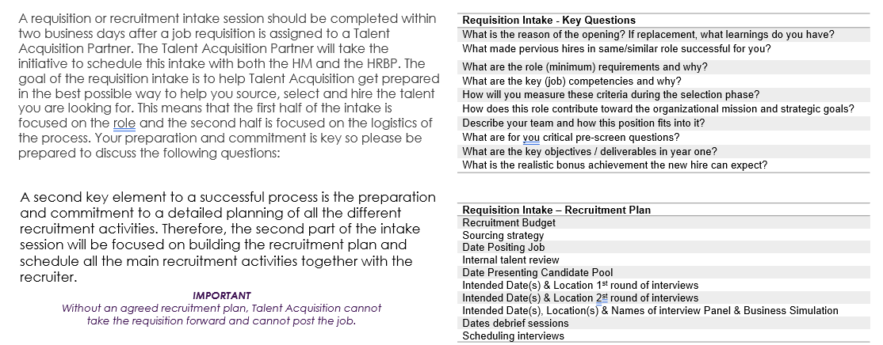
Recruitment Intake

Slide 9
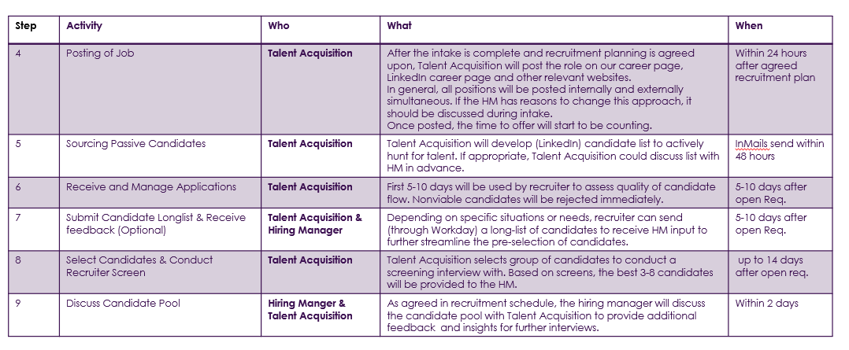
Phase 2: Sourcing

Slide 10
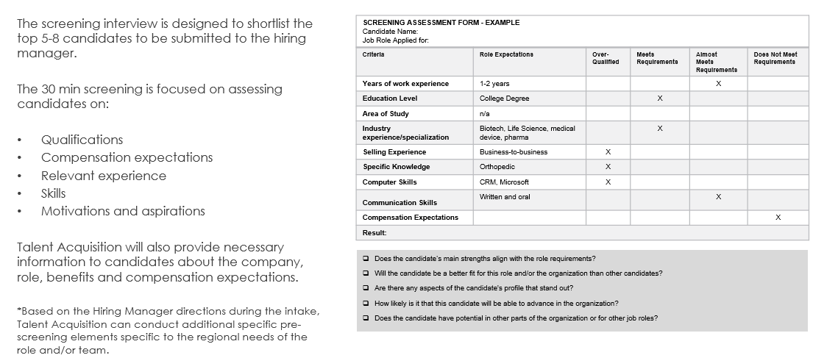
Recruiter Screening

Slide 11
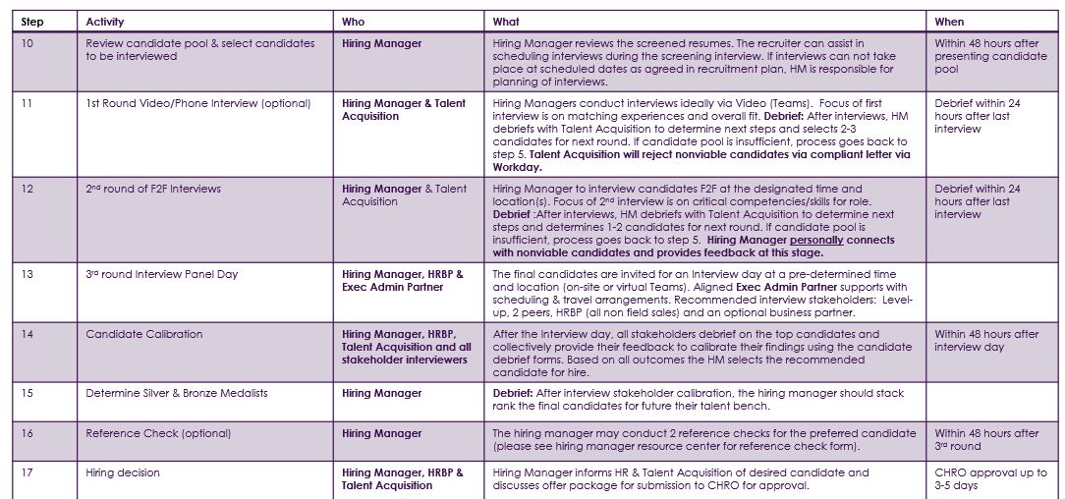
Phase 3: Selecting

Slide 12
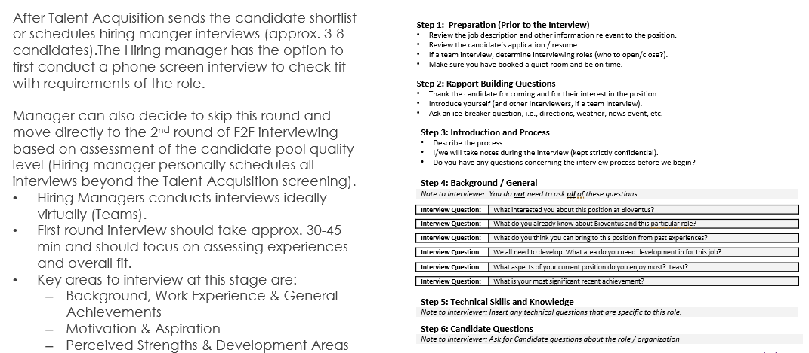
1st Round Virtual Interview

Slide 13
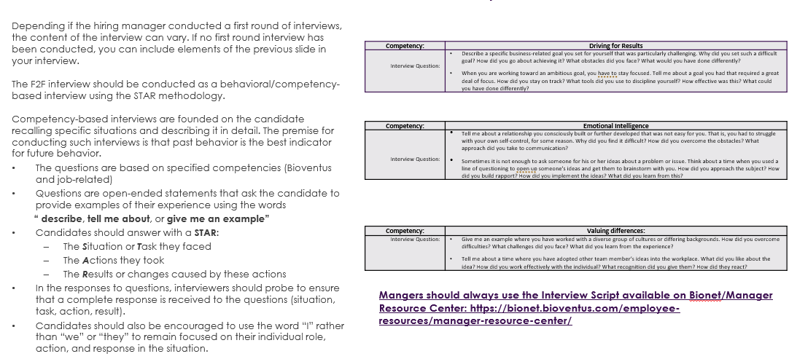
2nd Round Face-to-Face Interview Example

Slide 14
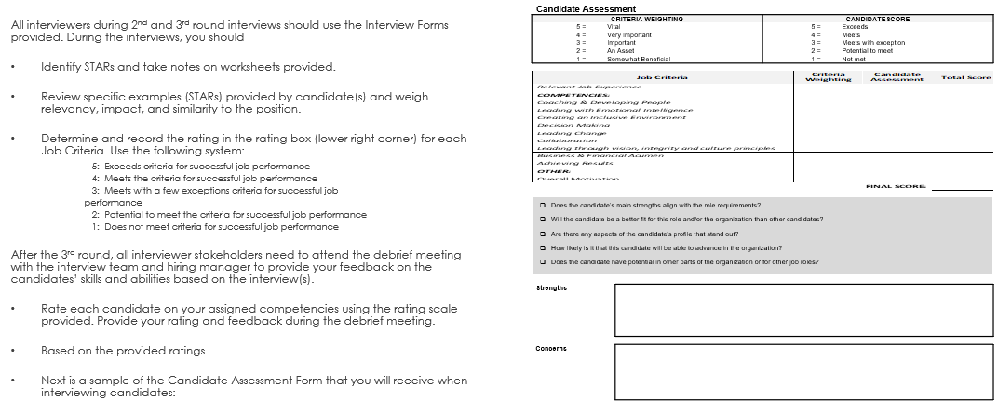
Panel interview de-brief

Slide 15
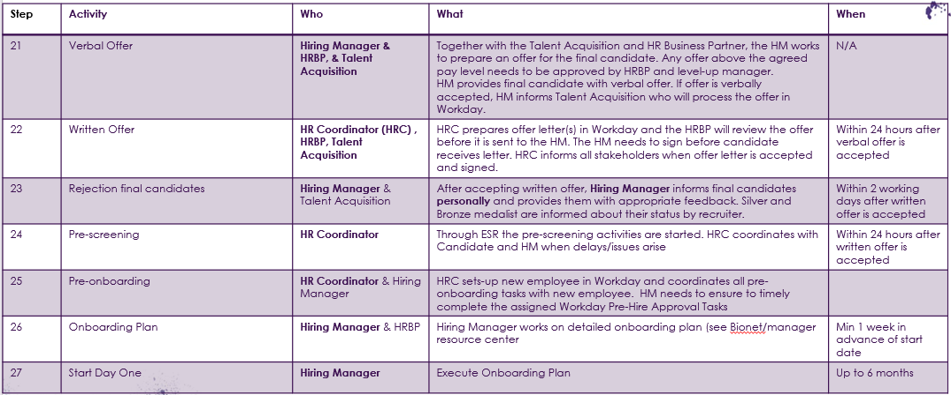
Phase 4: Hiring

Slide 16
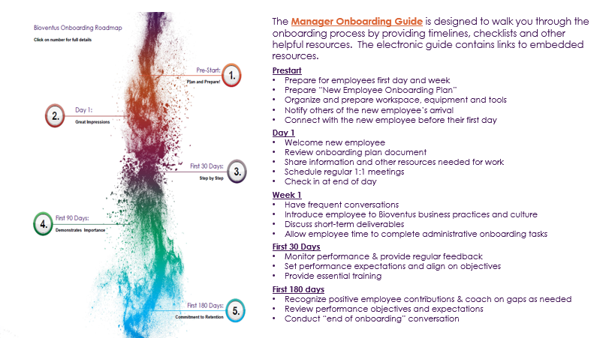
Leaders onboarding guide

