Slide 1


Slide 2
BV Access Request System
Identity & Access Management
IT Security

Slide 3
What applications are in Scope? Sarbanes Oxley (SOX)
Microsoft Active Directory
ADP
Microsoft Azure
Blackline
Dell Boomi
Brightree
  BPC/AR Dashboard
Concur
DocuSign
Equity Edge Online
Oracle NetSuite
Oracle PBCS
Okta
Salesforce.com
SAP
Vertex
Workday
Workiva

Slide 4
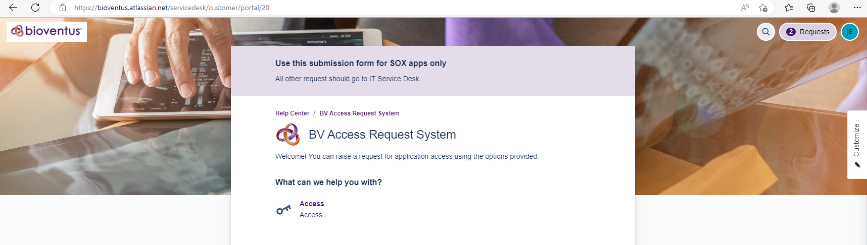
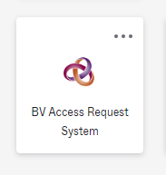
Accessing BV Access Request System
access.bioventus.com
Okta Portal

Slide 5
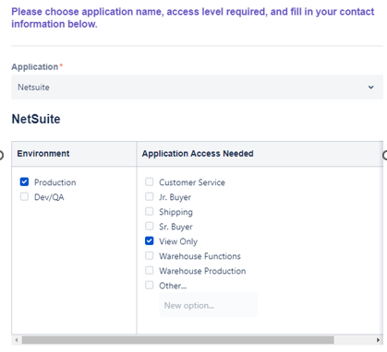
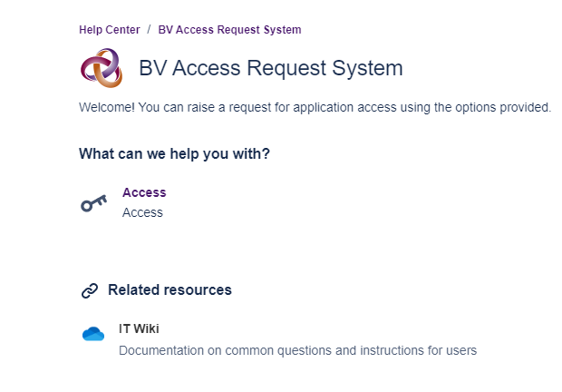
Access Request Process
Click on the Access link
Application – Select the application you are requesting access to from the drop-down list.
Application must be listed on slide 2

Slide 6
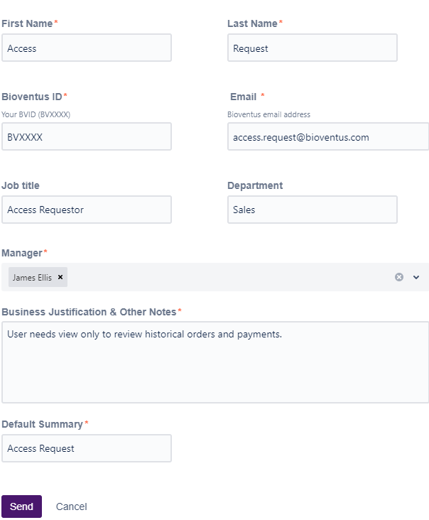
Request Process cont’d…
First Name – Employee needing access (First Name)
Last Name – Employee needing access (Last Name)
Bioventus ID – Employee needing access (BV Number)
Email – Employee needing access (Email address)
Job Title – Employee needing access (Job Title)
Department – Employee needing access (Department)
Manager – Manually type in your manager’s name. If this is not correct, it will not be approved.
Business Justification & Other Notes – reason this access is needed. Please add any additional notes here that may be helpful in getting your request processed more efficiently.
Next Steps:
Your request will now be sent to a manager for approval and/or the application administrator.
Your access request will be evaluated to confirm the requested access contains no risks.
Once approved, your request will be processed.
Next, you will be notified that your request has been processed and you have been provided the requested access.
Last, please confirm your request has been properly completed.

Slide 7
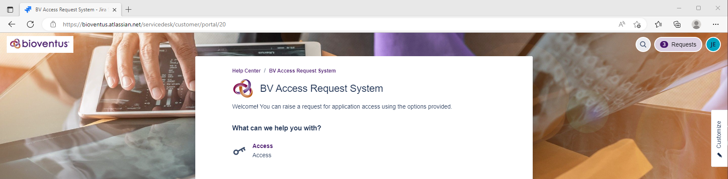
Manager & System Owner Approval Process
Access.Bioventus.com or Okta Portal
Select Requests
Manager and System Owner
will receive email notifications

Slide 8
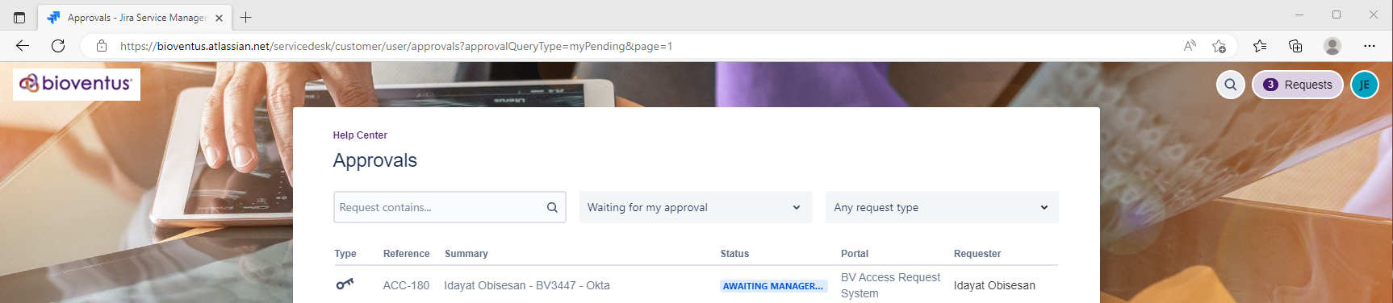
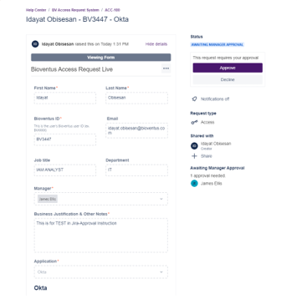
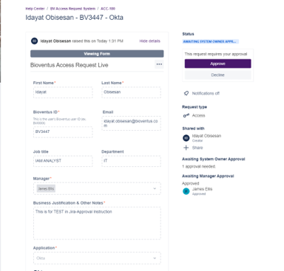
Manager & System Owner Approval Process
Manager approval
System Owner approval

Slide 9

Approvals Process Completed
Once the manager and system owner have approved the request. It will be assigned to the access admin of the application to provision the access.
Requestor will be notified via email that access has been provisioned

Slide 10
Assistance
For assistance send an email to ITSecurity@Bioventusglobal.com
Subject Line: Access Request

Slide 11
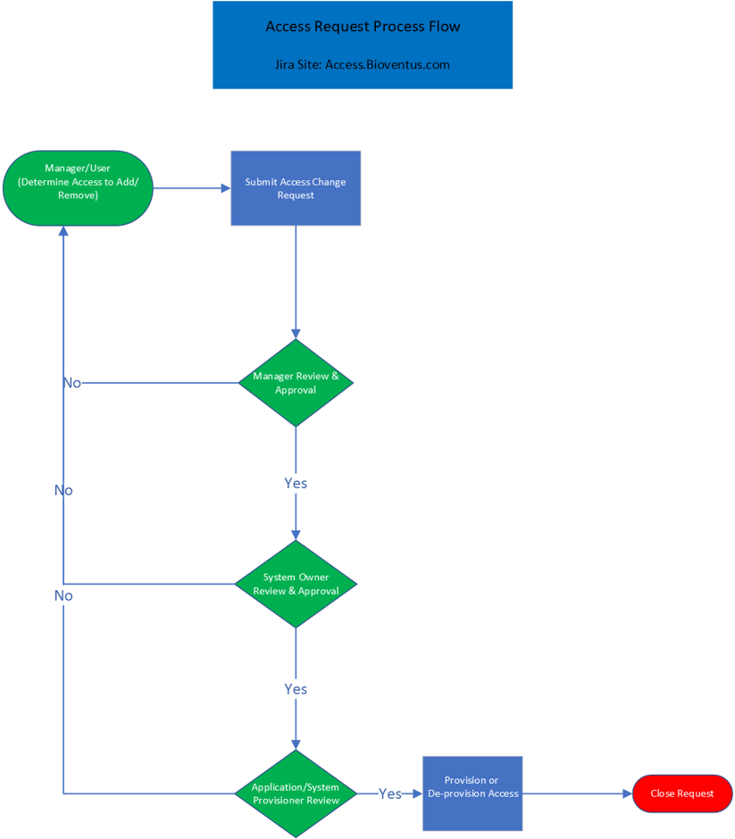
End to End Process Diagram

