Slide 1
Indirect Vendor Setup
Work Instructions

Slide 2
Vendor Setup Link
  https://na2.docusign.net/Member/PowerFormSigning.aspx?PowerFormId=267492d4-a864-4906-b9ef-574ee8f60681

Slide 3
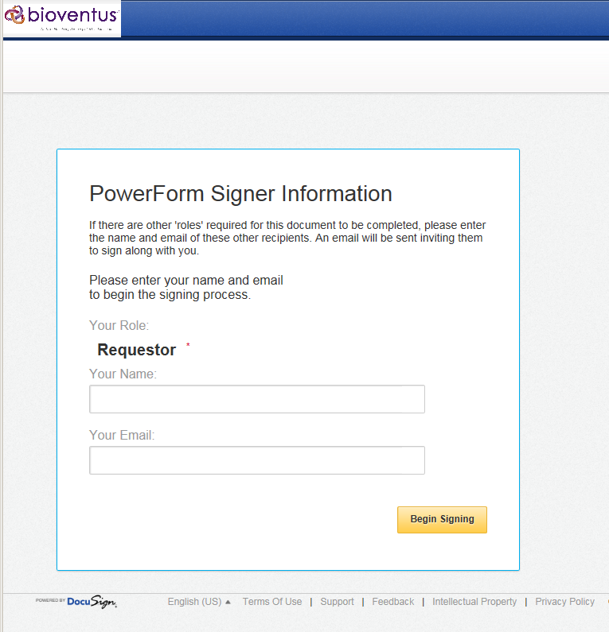
Enter your name + your email address
Select ‘Begin Signing’

Slide 4
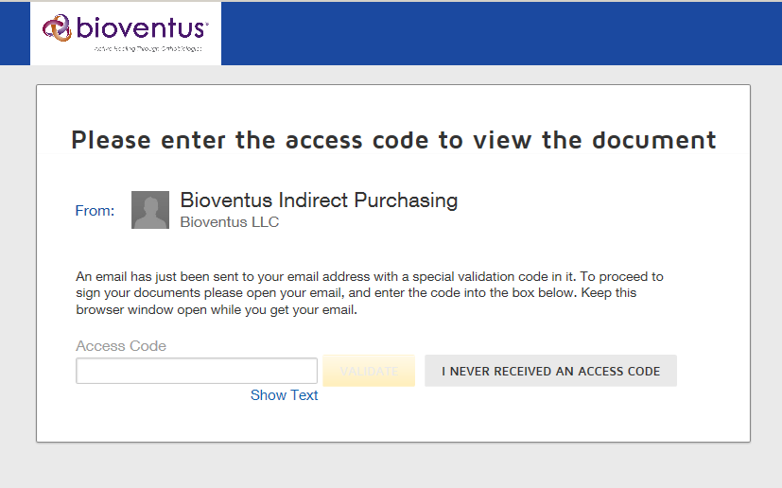
Next screen ask for an ‘Access
Code’ to verify your email

Slide 5
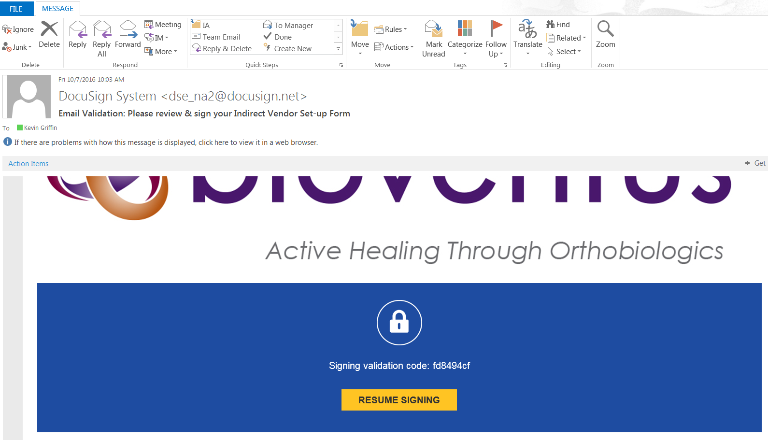
You will receive an email with a validation code.

Slide 6
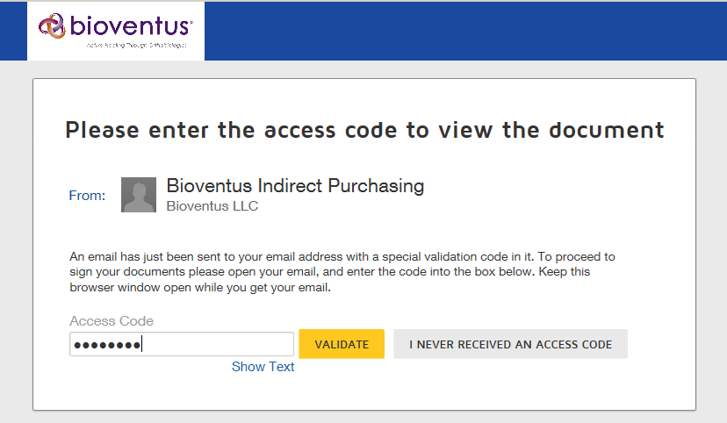
Enter ‘Access Code’
Select ‘Validate’

Slide 7
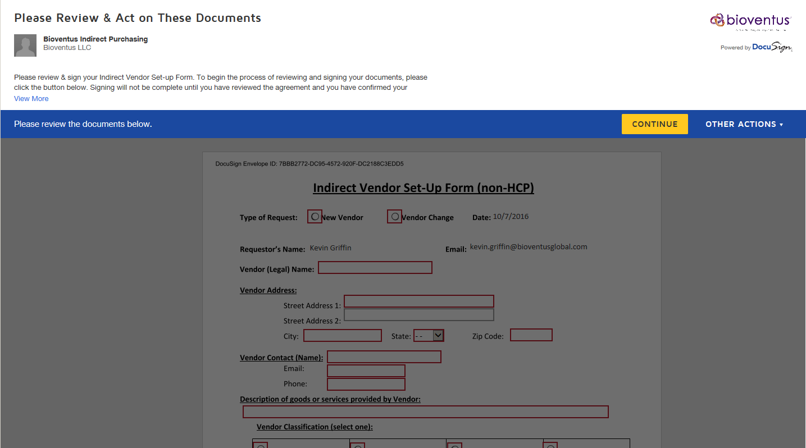
select ‘Continue’

Slide 8
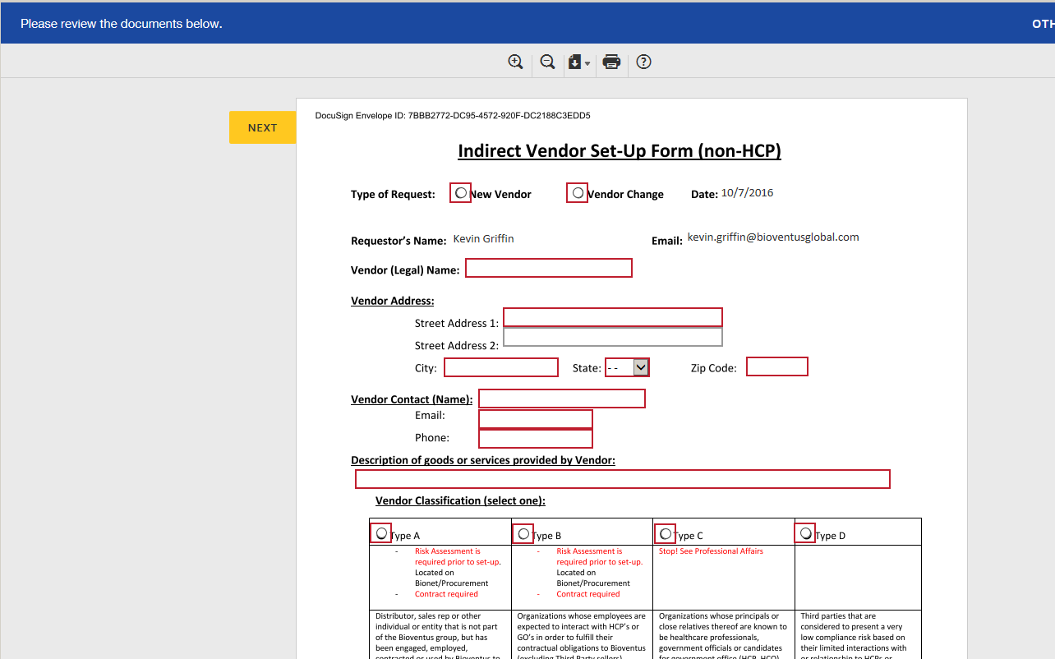
Complete ALL highlighted sections
on the form. Required.

Slide 9
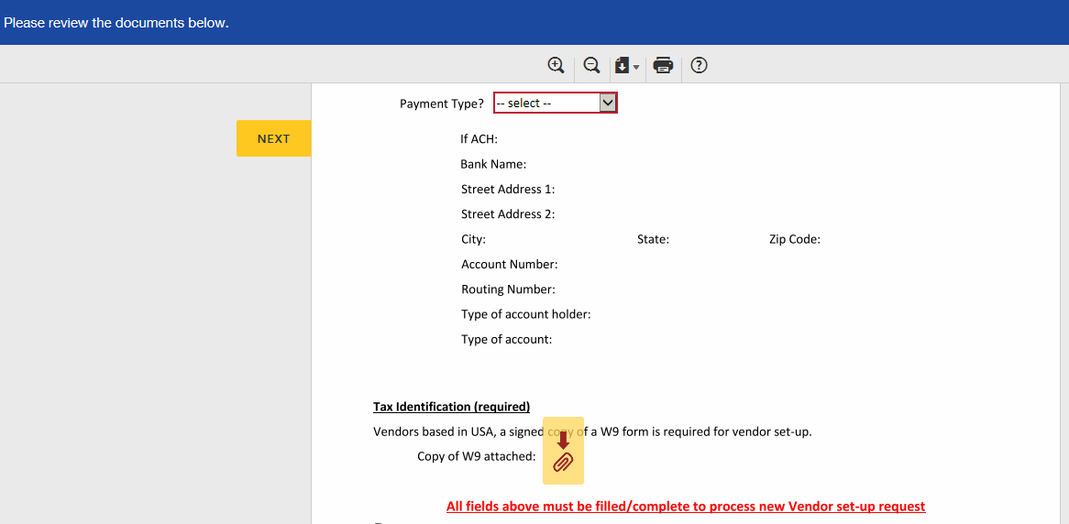
After all questions have been answered, upload a copy of the Vendor signed W9.
W9 must be signed and current

Slide 10
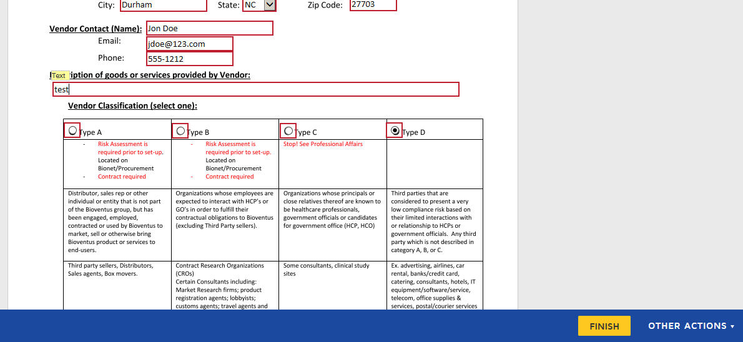
Once ALL fields have been completed & a W-9 has been uploaded, ‘FINISH’ will appear. Select.

Slide 11
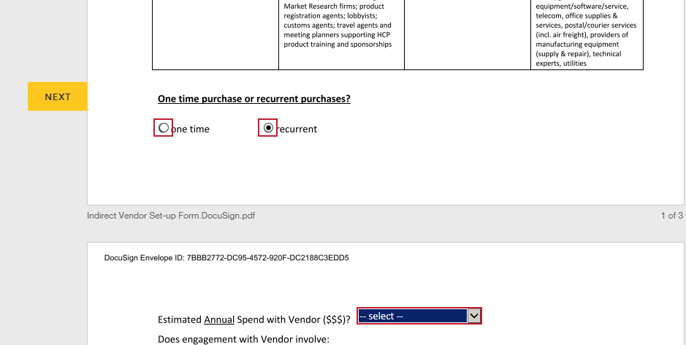
If the ‘FINISH’ button does NOT appear, use the ‘NEXT’ button to see which fields are incomplete.

Slide 12
Indirect Vendor Setup
Once ‘FINISH’ button has been selected, your request will go to Procurement.
Procurement will process. Following approval, the request will go to Accounts Payable for entry into SAP.
Accounts Payable will process & following approval the request will go the Accounts Payable Manager for final verification.
Accounts Payable Manager will approve and the SAP vendor # will become active.
Following, the completed vendor setup form including the new SAP Vendor # will be emailed to the Requestor and Procurement.

Slide 13
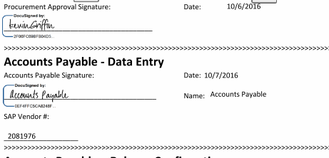
On the confirmation email, new SAP vendor # will be indicated.
Vendor # is required for creation of a PO
Under normal circumstances and assuming no follow-up concerns, new Vendor setup takes 24 - 48 hours.

