Slide 1
PO Creator Training Refresh
Quarterly | March 2025 with Tretta Bush

Slide 2

Agenda
What to Expect
PO Creator Role and Responsibilities Clarification of duties and expectations
Tools and Resources Refresh
Overview of essential procurement tools and best practices
Defining Key P2P Stakeholders
A list of contacts by topic
Questions and Discussion
Interactive dialogue

Slide 3
PO Creator Role and Responsibilities
4 pillars of PO Management
PO Processing: Process purchase order (PO) requests for goods and services per requester direction.
PO Delivery: Collaborate with requesters to provide vendors with PO details and invoicing instructions after PO approval.
01
02
03
PO Corrections: Address correction requests from Accounts Payable and PO Approvers timely.
04
PO Monitoring: Track open POs with cost center owners to ensure sufficient funding and resolve invoice related issues.
t
a
s
k

Slide 4
Tools and Resources
Your secret sauce for success.
IMPORTANT!
1
Software
2
Open PO Report
3
PO Exemption List
Utilized for tracking PO requests, managing approvals, vendor communication, and processing orders efficiently.
Provides visibility into outstanding POs, helping ensure sufficient funds and proactive blocker resolution.
Identifies purchase categories that do not require a PO.
4
Create New Vendor Form
5
Existing Vendor Change Form
6
FP&A Partner Matrix
Captures essential details to onboard new vendors to enable timely invoice and payment processing.
Used to facilitate updates to vendor information – address, payment method, email, etc. New tax IDs require a new vendor setup.
Aligns FP&A contact with cost centers to assist with PO funding and coding inquiries.

Slide 5


Tools and Resources: Documentation and Communication
Business Inquiries:
PO Requests
PO Follow-ups
Samanage Notifications
AP Inquiries:
PO Funding
PO Errors
PO Requests
PO# Updates
POs In Approval
System of Record:
Create POs
Proactively Maintain PO Funding (via Manage Purchase Orders)
Print PO Copies
Software
*license required*
*access required*
OUTLOOK
SAMANAGE
SAP

Slide 6
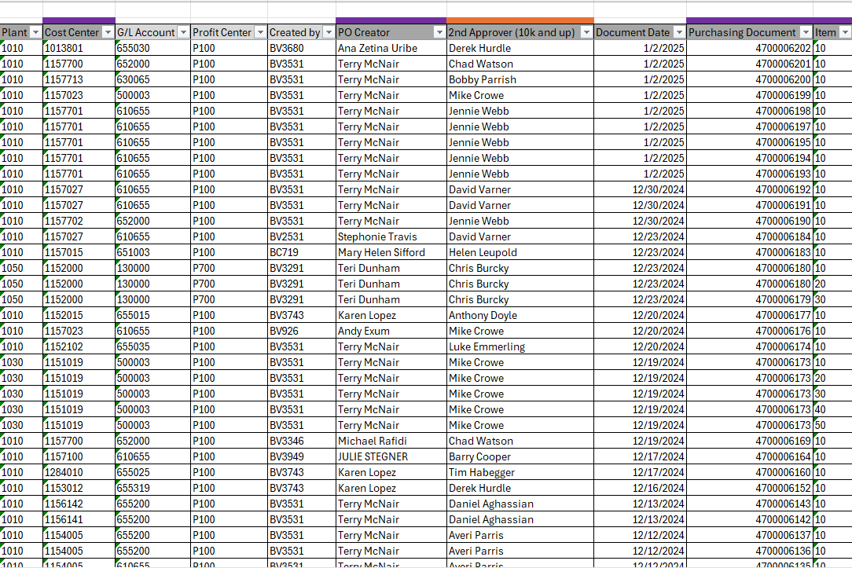
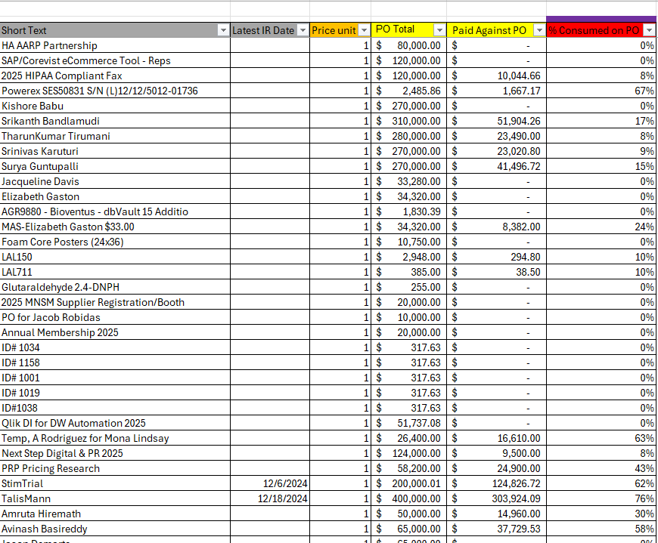


Tools and Resources
Real-Time Walkthrough
Open PO Report
A weekly consumption review by PO line.
Open PO Report
Key Data Points: Cost Center | PO Creator | Purchasing Document | Item# | %age of Consumption
Confidential
6/12/2025

Slide 7
Tools and Resources
Open PO Report
A weekly consumption review by PO line.
Sort by PO Creator or BV#
Assess consumption levels (or create a new PO) when usage reaches 80%, if necessary.
Close POs if no further invoices are expected.
Consult your VP or FP&A partner for funding clarity as needed.
Open PO Report
Key Data Points: Cost Center | PO Creator | Purchasing Document | Item# | %age of Consumption
Confidential
6/12/2025

Slide 8
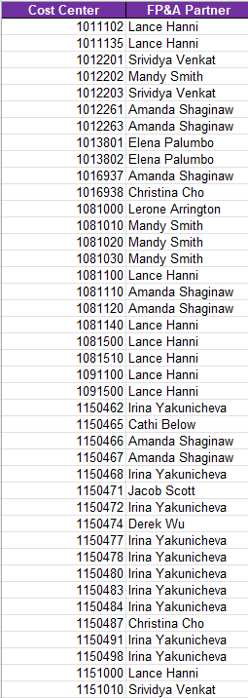
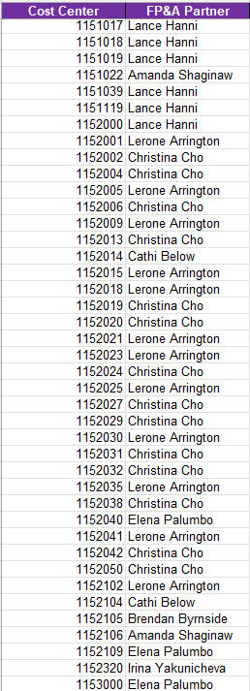
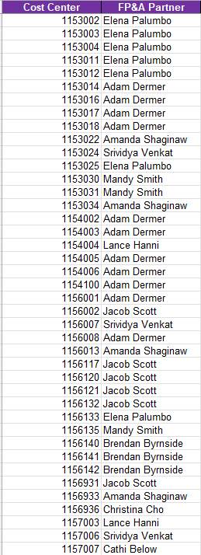
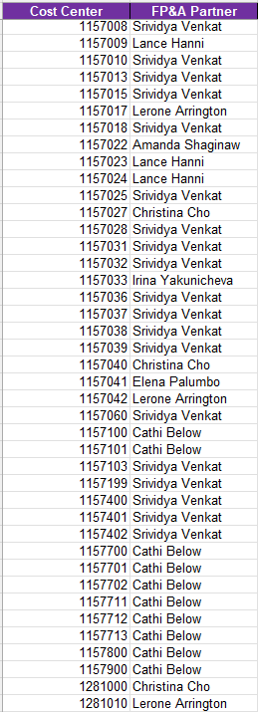
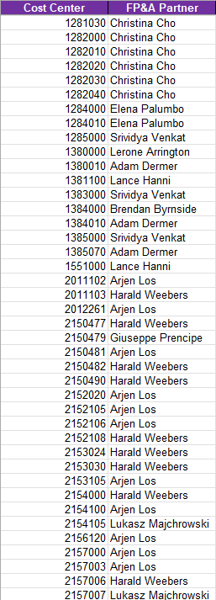
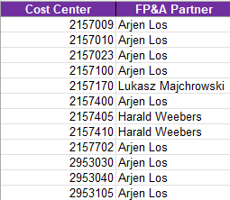

Tools and Resources: FP&A Partner Matrix
A monthly cost center to Finance partner alignment.
Expense Coding Requirements:
  Company Code
  GL #
  Cost Center
  Profit Center
Use this report to obtain PO funding and coding guidance from your assigned Finance partner.
Confidential
6/12/2025

Slide 9
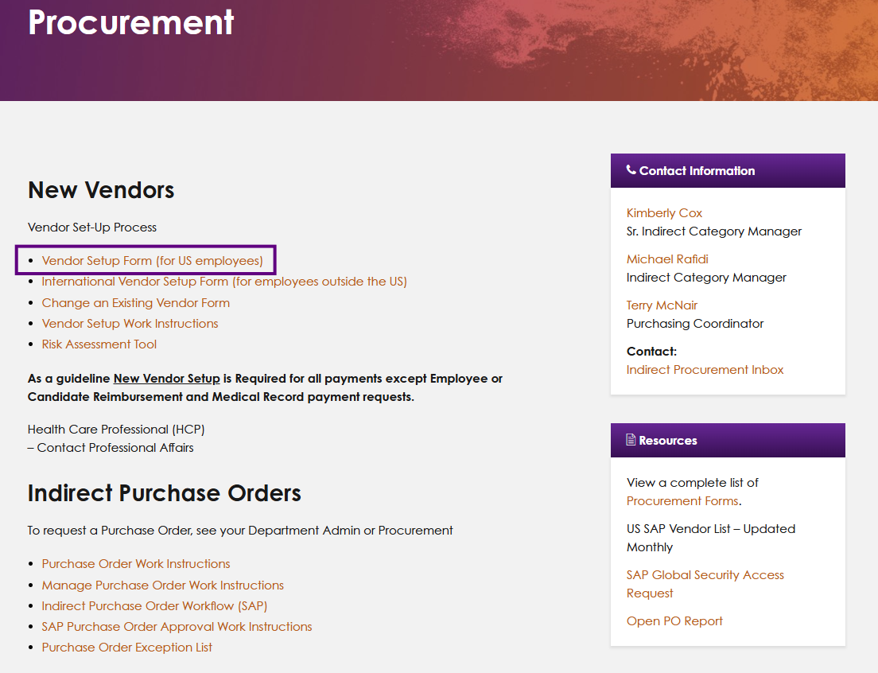
Tools and Resources
Create New Vendor
Onboard new vendors to enable timely invoice and payment processing.
ACH is the standard and preferred payment method; a bank letter is required.
“Due on Receipt” or immediate pay demands are not permitted.
A signed W-9 is required for processing.
Monitor request via DocuSign
Open New Vendor Form
Requests must clear Compliance, Procurement, Regulatory, Cyber Security, Master Data, and AP before approval.
Confidential
6/12/2025

Slide 10
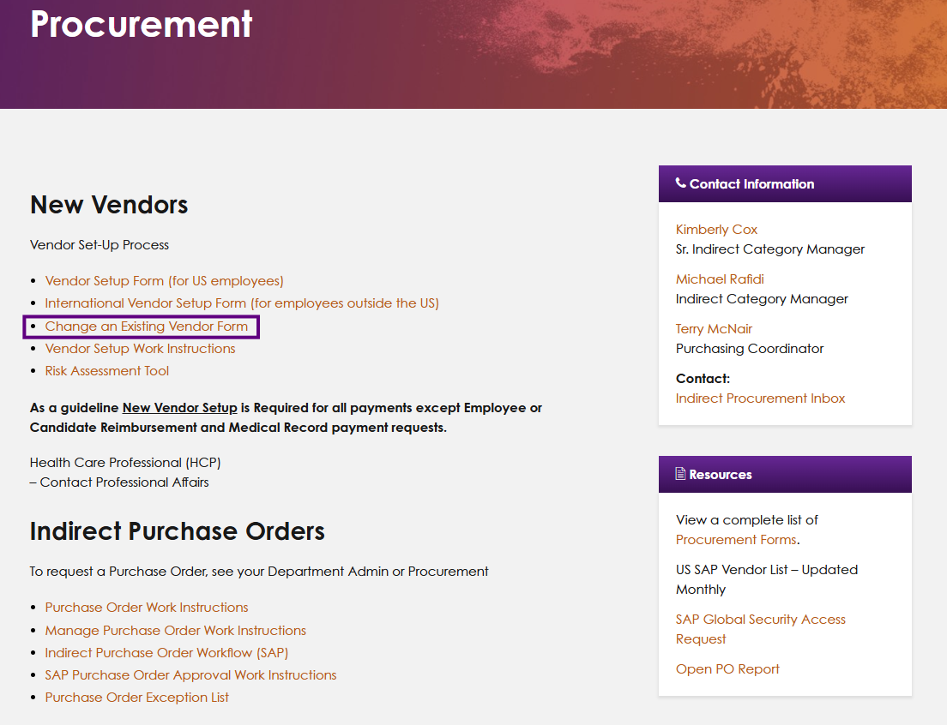
Tools and Resources
Existing Vendor Changes
Facilitate updates to existing vendor records.
Required Fields:
Vendor Name
Vendor ID
Specify Updates
Leave unchanged fields blank.
Monitor request via DocuSign.
*
*
Open Existing Vendor Change Form
Change requests must clear Compliance, Procurement, Regulatory, Cyber Security, Master Data, and AP before approval.
Confidential
6/12/2025

Slide 11
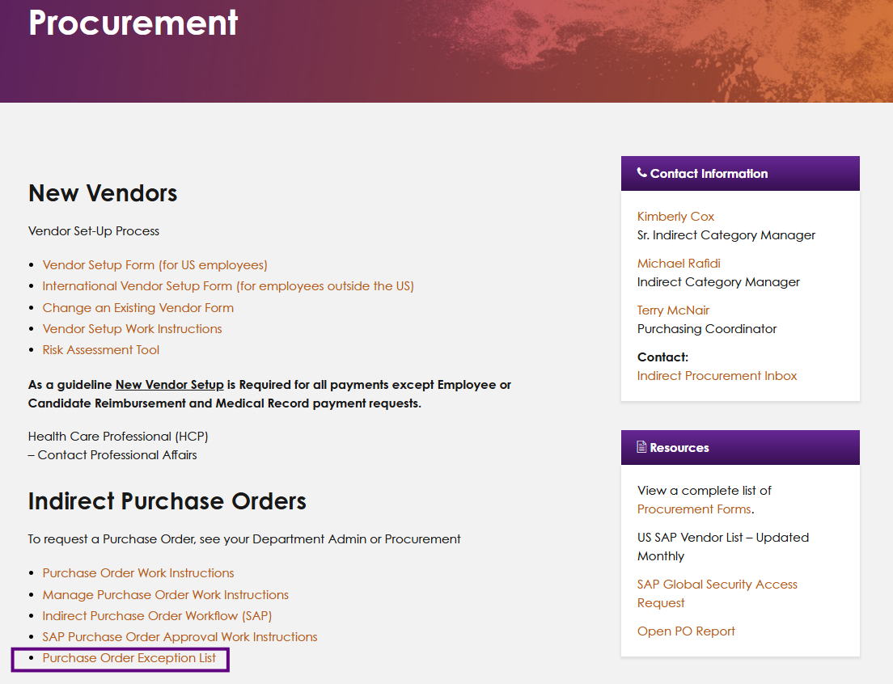
Tools and Resources: PO Exemption List
Purchasing categories that do not require a PO
Operational Business Licenses
Educational Grants
Candidate Reimbursements
Freight
HCP Payments
Insurance
Legal Firms, Attorneys
Lease payments
Rebates & Royalty payments
Travel (air, hotel, car rental, etc)
Academic Institutions
Telecom
This is a limited list. Access the full list on Bionet or click the orange button.
Open Full Exemption List
Confidential
6/12/2025

Slide 12

Essential Links
Click to unlock the basics of purchase order management
Manage Purchase Orders SOP
FP&A Partner Matrix
Vendor Contracts
Open PO Report
Vendor Setup SOP
New Vendor Form
Existing Vendor Change Form
PO Exemption List
AP/Procurement Contact List
Temp Labor PO Request Form
Indirect Purchasing Policy
Create a PO (SOP)
*To open the links, 1) right-click the button, go to "Hyperlinks," and select "Open Hyperlink” or 2) enter Presenter mode, find this slide, and click the button of choice.
  Procurement Inbox: bioventusindirectpurchasing@bioventus.com | Documents are saved on Procurement’s Bionet page.

Slide 13
Tools and Resources: Key P2P Stakeholders
Contacts by topic
Topic | Team | Contact
Invoice Approval Inquiries | Accounts Payable | bioventusap@bioventus.com
Invoice Payment Inquiries | Accounts Payable | bioventusap@bioventus.com
Invoice Posting Inquiries | Accounts Payable | bioventusap@bioventus.com
Invoice Receipt Inquiries | Accounts Payable | bioventusap@bioventus.com
New Vendor Set Up Form | Procurement | bioventusindirectpurchasing@bioventus.com
Open PO Report Inquiries | Procurement | bioventusindirectpurchasing@bioventus.com
PO Coding Clarification | FP&A | See FP&A Partner Matrix (slide 7)
PO Creation Inquiries | Procurement | bioventusindirectpurchasing@bioventus.com
PO Creator Change/Update Requests | Procurement | bioventusindirectpurchasing@bioventus.com
PO Funding Clarification | FP&A | See FP&A Partner Matrix (slide 7)
PO Maintenance/Change Inquiries | Procurement | bioventusindirectpurchasing@bioventus.com
Samanage Training/Inquiries | Accounts Payable | bioventusap@bioventus.com
SAP Training/Inquiries | Procurement | bioventusindirectpurchasing@bioventus.com
Temp Labor/Contingent Worker Inquiries | Procurement | bioventusindirectpurchasing@bioventus.com
Vendor Change Request Form | Procurement | bioventusindirectpurchasing@bioventus.com
Vendor Contracts | Procurement | bioventusindirectpurchasing@bioventus.com
Vendor Terms Changes | Procurement | bioventusindirectpurchasing@bioventus.com

Slide 14
Thank You
Questions / Feedback / Discussion

