Slide 1
Preferred-Contracted-Staffing-Agencies Process

Slide 2
Overview
At Bioventus, contract staff plays a vital role in our workforce. This work instruction is designed to offer a comprehensive insight into the essential processes and procedures related to contract staffing. Users will benefit from a detailed understanding of the following key areas:
List of Approved Preferred Contract Staffing Agencies: Gain access to our approved network of reliable staffing agencies.
Purchase Order Requirements for Contract Staffing: Understand the necessary steps and requirements for initiating contract staffing through Bioventus.
Onboarding HR Process: Navigate through the seamless onboarding process for contract staff, ensuring a smooth integration into our organization.

Slide 3
Goals and Outcomes
Streamline the procurement process by having pre-vetted vendors readily available, which can reduce the time and effort required to find and evaluate potential suppliers or contractor.
Reduce risks associated with engaging with unknown or unverified vendors by working with those who have been thoroughly assessed and have a history of reliable performance.
Ensure that the vendors on the list have a proven track record of delivering high-quality goods or services, which can help maintain or improve the company's own product or service quality.

Slide 4
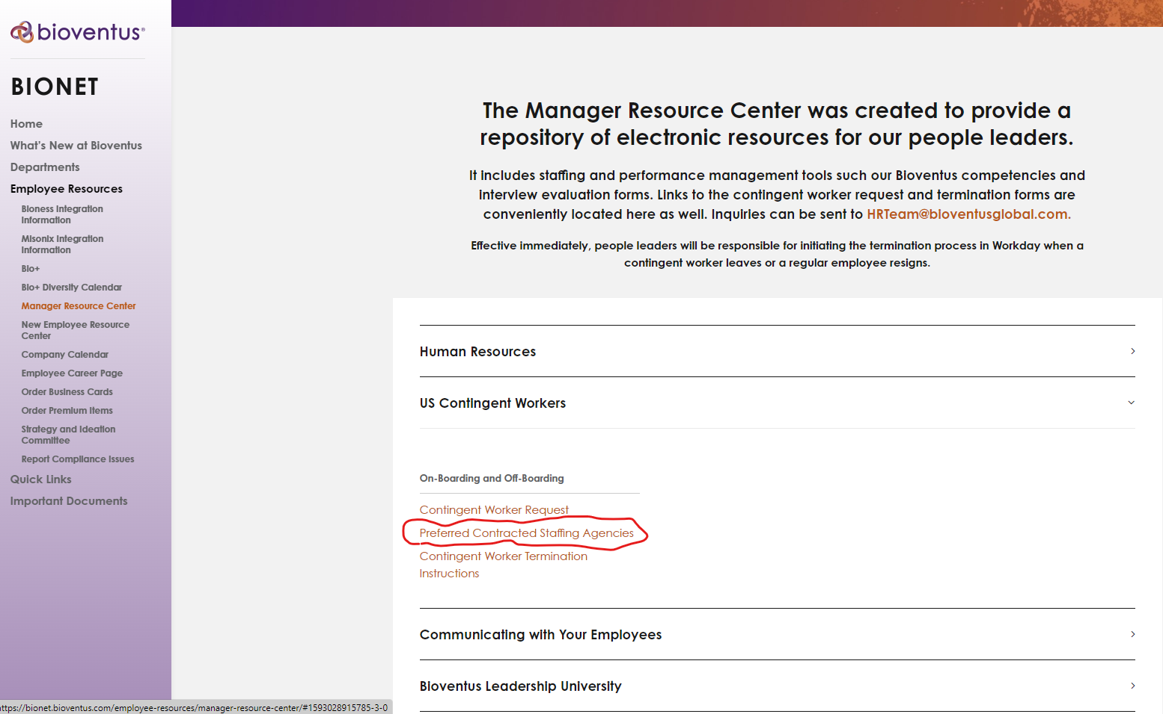
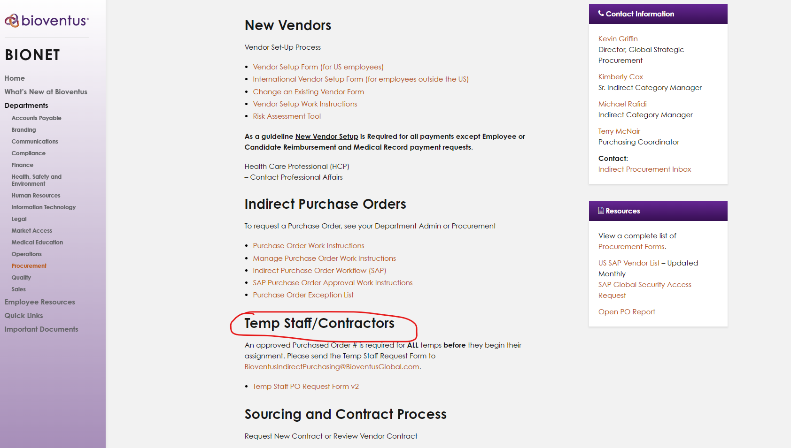
List of Preferred-Contracted-Staffing-Agencies
Bioventus has a preferred contract list of staffing agencies that have been evaluated for top quality and service.
The List of Preferred-Contracted-Staffing-Agencies location: Bionet - Department - Procurement–Temp Staff/Contractors and Employee Resources- Manager Resource Center-Us Contingent Workers

Slide 5
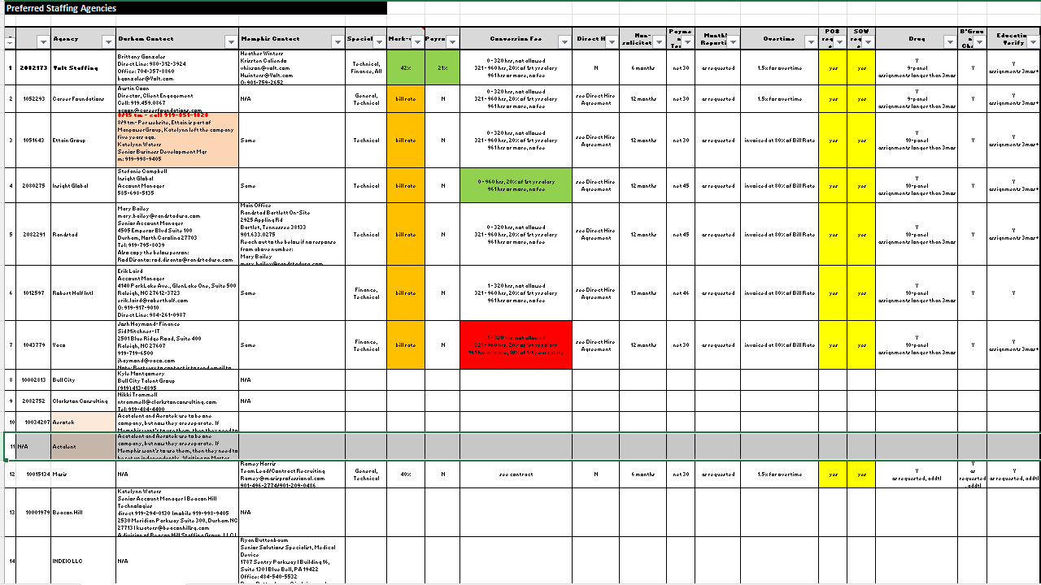
List of Preferred-Contracted-Staffing-Agencies
There are 14 approved staffing agencies available for selection, tailored to the specific requirements and Bioventus location.

Slide 6

Temp Checklist
Use your Bioventus Credentials As Normal
  Please ensure the following information is obtained from the Temp Agencies when requesting staff as part of the vetting process for prospective Bioventus Temporary employees.
Drug Screening
Background Check
Education
Appropriate level of Insurance.
Adhere to Code of Compliance and Ethics

Slide 7

Reminder!
A Purchase Order is Required for all Contingent workers
Identify Purchasing Need based on approved budget
Initiate PO
Issue approved PO to Vendor to initiate service or goods
Invoice is sent to Accounts Payable & Vendor is paid
Services or goods provided
Route PO for Approval
Purchase to Pay Workflow

Slide 8
PO Checklist
Use your Bioventus Credentials As Normal
  The following information is required to create a Purchase Order. This information may be obtained from the PO Requestor or Finance.
Vendor Number
Cost Center
GL
Profit Center

Slide 9
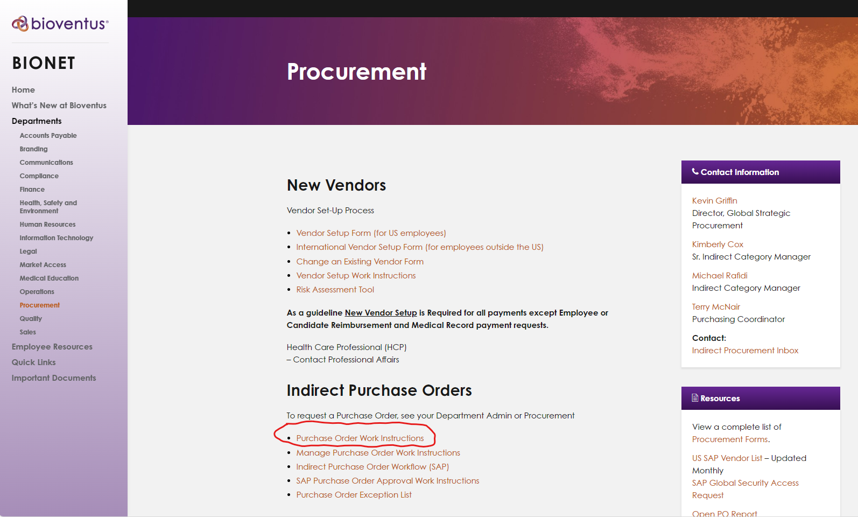
Purchase Order Work Instructions
The Purchase Order Work Instruction is available at Procurement – Bionet (bioventus.com)
The purpose of this document is to provide a clear step by step work instruction on how to create a purchase orders for business purchase.

Slide 10

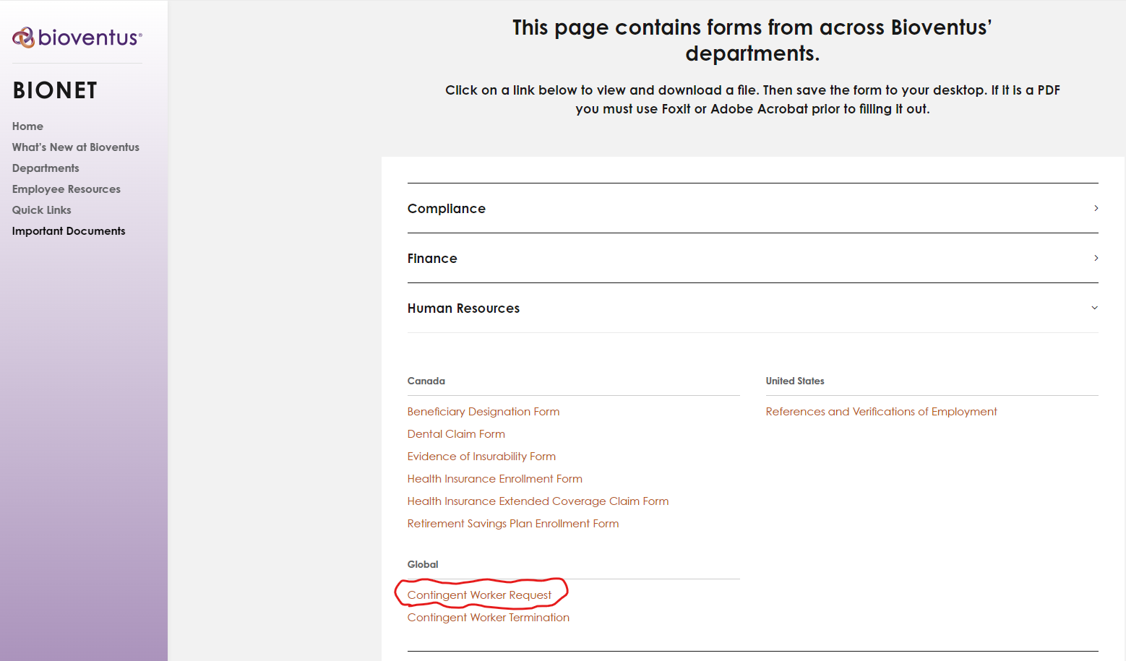
Contingent - On Boarding Process
Bioventus has a contingent worker On Boarding process.
To initiate this process, a Contingent Worker Request must be completed.
The Contingent Worker Request form is available at Procurement – Bionet (bioventus.com)

Slide 11

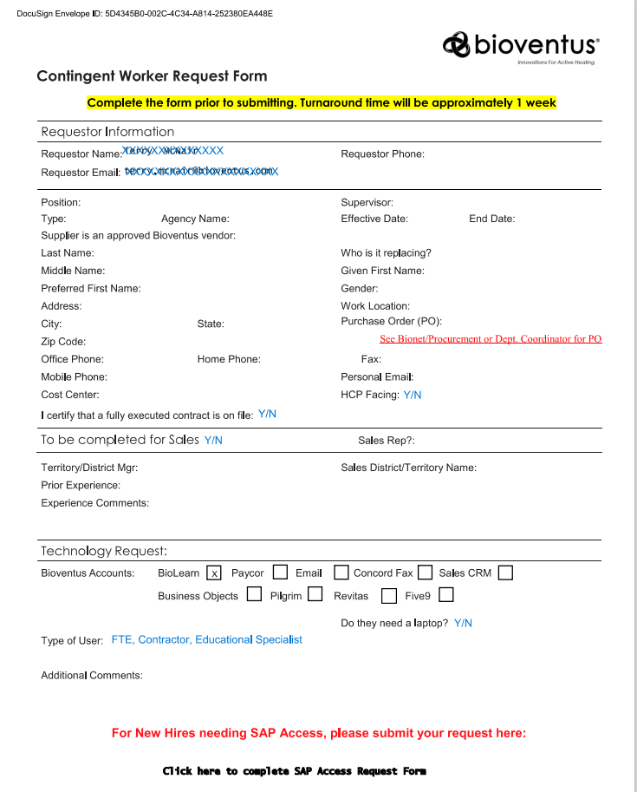
Contingent Worker Request Form
The onboarding process has a Turnaround of approximately 1 week.
A Purchase order is required to submit the Contingent Work request.

Slide 12
