Slide 1
Talent Reward Program
#Ready to Work for a More Active World!

Slide 2


Talent Reward Program
# Ready to Work for a More Active World?
Our ambition
“To create a program which engages our employees to utilize their professional and personal networks to support Bioventus’ strategy to attract the best talent”
Make an Impact
Value Others
Growth through Challenge and change
Patient Impact

Slide 3
So what is our Talent Reward Program?
Broader Program
  Employees become Talent Ambassadors
  Employees engaged to identify great talent for Bioventus
First Incentive – attracting talent : $75 award through payroll when a referred candidate is interviewed by Hiring Manager
Creating specific training
Rewarding success at more stages of the recruitment process
Webinar (recorded) for employees on how to use Workday and Linkedin as a tool for sharing job postings
LinkedIn/ Social Media training on how to successfully attract talent online
Second Incentive – hiring talent : $600 award for when a referral is hired (i.e. day 1)
Third Incentive – retaining talent : $600 award for when a referral is retained (i.e. 6 months)

Slide 4
Alternative to cash for rewards
Personal Development Booster
Employee wants to use their award for professional development
Charitable Donation
For those who want to contribute to a good cause, Bioventus will double the amount making the total potential donation $2,000 per successful referral. You want to use your money toward a cause important to you!
Second Incentive $600 + an additional $400 = $1,000 for professional development
Third Incentive $600 + an additional $400 = $1,000 for professional development $2,000 total professional development
Second Incentive $600 + an additional $400 = $1,000 charitable donation
Third Incentive $600 + an additional $400 = $1,000 charitable donation $2,000 charitable donation
Growth through Challenge and change.
Valuing Others

Slide 5
And we don’t stop there!
Quarterly Recognition
Each quarter a dashboard shared with top ambassadors. The winner will receive a $250 bonus and the second place will win $100.
Ambassador of the year - Annual Award
CEO recognition – Top Talent Ambassador of the Year Award of $ 1,000.
The most successful Talent Ambassador receives a CEO Award
Make an Impact

Slide 6





Charitable Donation: “Value Others”
Bioventus will add up to $800 if you want to donate your reward
Total donation up to $2.000
Full rules and conditions found on Bionet

Slide 7






Personal Development Booster: “Develop ourselves”
Bioventus will add up to $800 if you want to use your reward to develop yourself
Total development reward up to $2.000

Slide 8

Incentive and Award Payment Information
All Cash Payments are processed through payroll ​
All Incentive and Award amounts for international employees will be calculated to local Currency using Bioventus Annual Exchange Rates ​
All Incentives, are considered taxable income and the amounts are therefore gross amounts. The taxation of the award will be processed through payroll at the time the award is given. ​
All referral bonus payments will be made according to the following schedule: ​
First Incentive – $75 bonus paid through payroll within 1month after the specific Job Opening has been closed ​
Second Incentive - the amount will be paid within 1 month after the referred employee’s 1st day of employment with Bioventus ​
Third Incentive - the amount will be paid within 1 month after the referred employee completes 6 months of service with Bioventus. ​
Quarterly Award – award amount will be paid in the month following the end of the quarter ​
Annual Award – will be paid the month following the annual CEO Award ceremony ​
To be eligible for payment of the incentives and/or awards, the referring employee must still be actively employed by the company at the time the payment. ​
If the referring employee has opted to use incentive(s) the Personal Development Booster and has not used the amount at the time of leaving Bioventus, Bioventus will pay the outstanding amount, less the additional incentive amount on last paycheck

Slide 9
What to do!

Slide 10
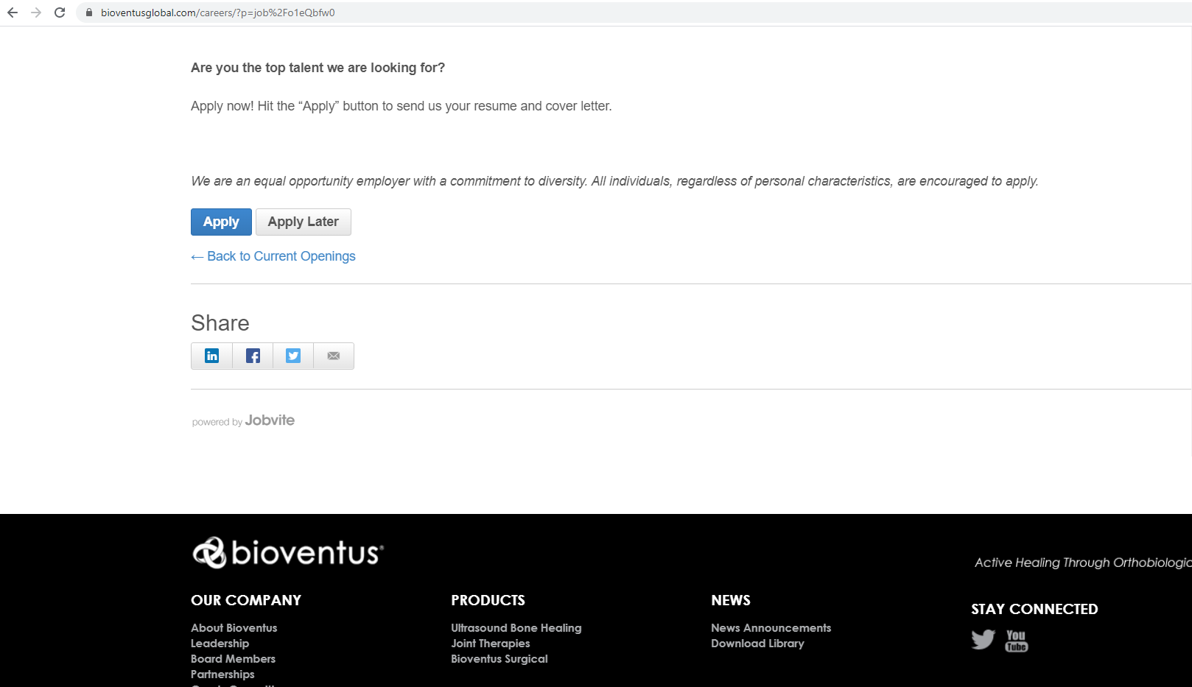


Go to: bioventus.com/careers
Go to the Job Opening you want to share
Choose your Social Platform or Email
One click and you will reach your targeted audience

Slide 11
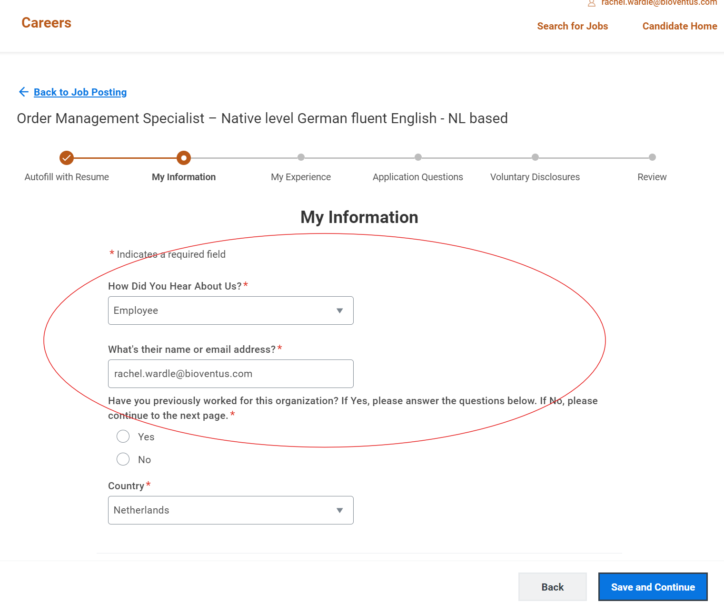
What your referrals need to do!
Everyone you refer, needs to apply first!
Ensure that they list your name when they apply
Or at the very least inform a member of the TA team.
Referrals will only be accepted if registered correctly and not after people are hired.

Slide 12

Additional Information:
Rules of the program are all available on Bionet.bioventus.com
Any questions around the information posted or program can be directed to a member of the Talent Acquisition team
Lets work together to achieve our goals in hiring, retaining and developing the best talent in the market.
We can only do this with your help!

